Slide 1
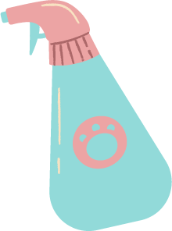
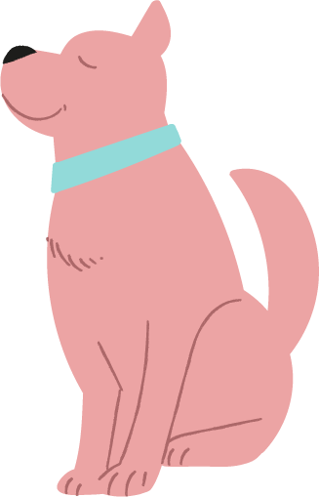
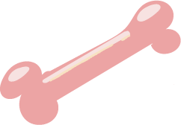
Dog Grooming
PRICE LIST
Basic Service
Shampoo + Blow dry + Nail + Ears
Toy
$7
Small
$9
Medium
$11
Large
$13
Special Bath
Shampoo + Blow dry + Nail + Ears +
Massage + Cologne
Toy
$7
Small
$9
Medium
$11
Large
$13
Premium Spa
Shampoo + Blow dry + Nail + Ears +
Massage + Cologne
Toy
$7
Small
$9
Medium
$11
Large
$13

