Slide 1
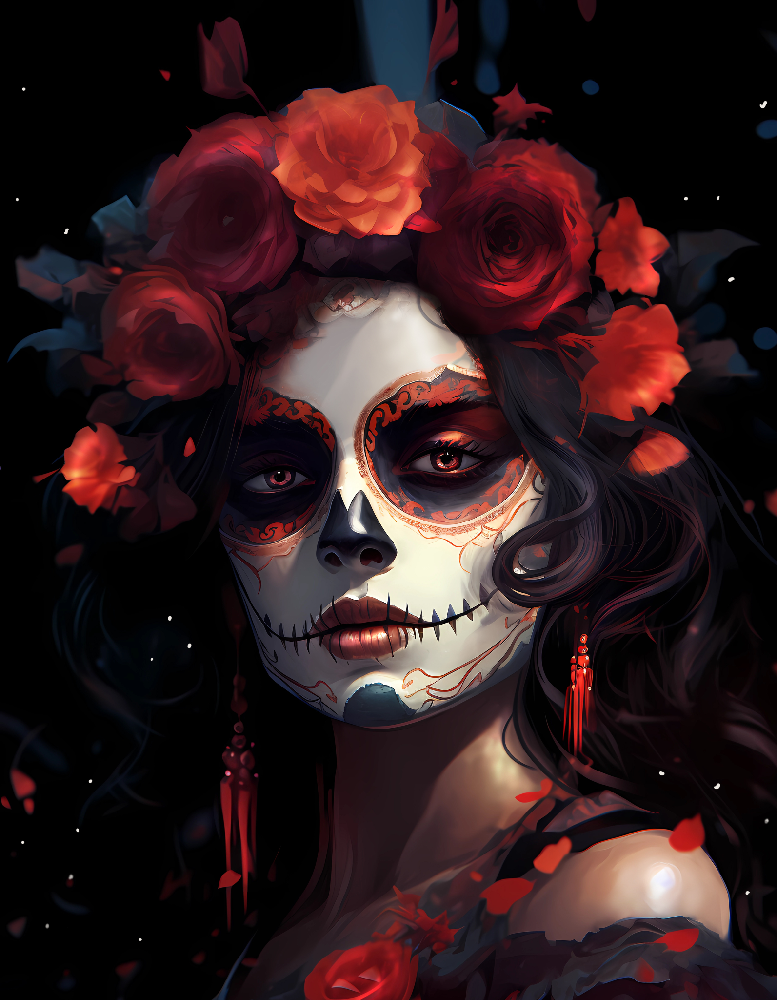

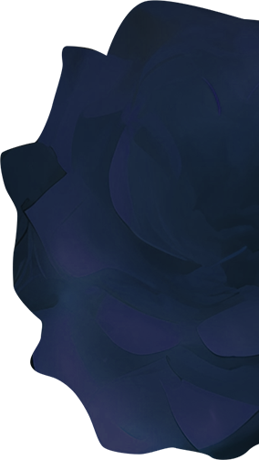

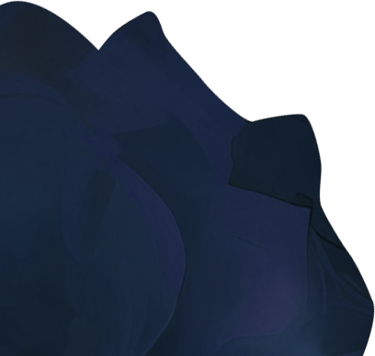
DIA DE LOS MUERTOS
Party
YOUR CLUB NAME PRESENT
YOUR CLUB NAME PRESENT
SPECIAL MEXICAN BUFFET | LIVE MUSIC | DANCING
FRIDAY OCTOBER 30 - 7PM UNTIL 10PM
WWW.YOURSITE.COM

