Slide 1
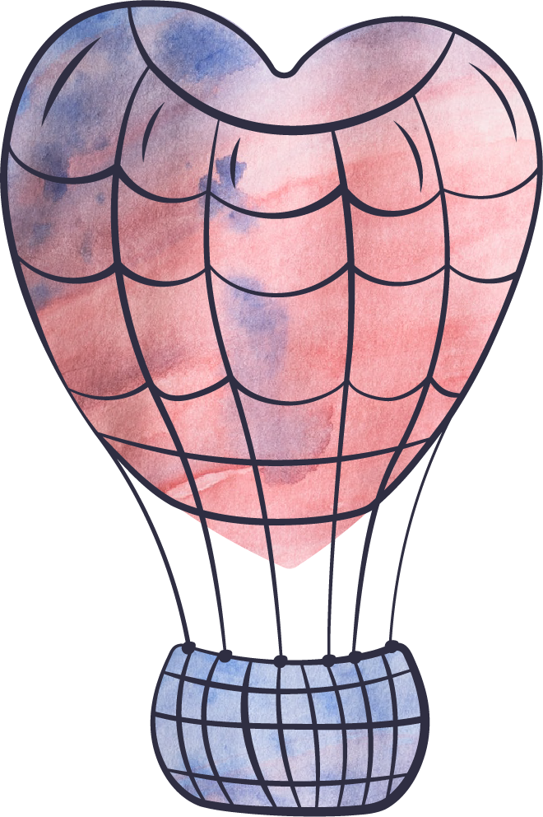
Happy
Valentine's day

Slide 2
I
love you

