Slide 1
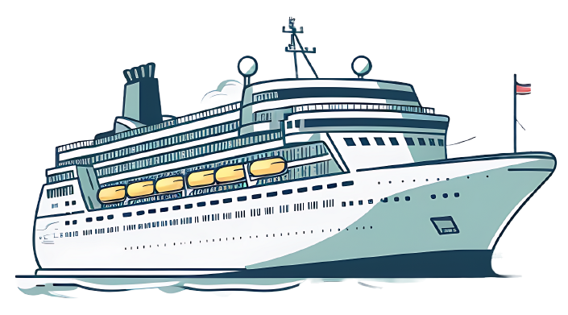
CRUISE VACATION
Packing List
Toiletries & Medications
Glasses
Hand sanitizer
Contraceptives
Hair products
Hair straightener
Anti-diarrheal medication
Chap Stick/lip balm
Vitamins
Cough drops
Contacts+solution
Bathroom spray
Cold medicine
Deodorant + wipes
Razors
Allergy medication
Mouthwash/floss
Pain reliever
Sunscreen (body & lip)
Soap/body wash
Tweezers + nail file
Travel emergency kit
Flushable wipes
Makeup/cosmetics
Aloe vera
Shampoo
Cotton balls + q-tips
Insect repellent (DEET)
Toiletry bag
Prescription medication
Sea bands
Toothbrush/toothpaste
Tissue/kleenex
Motion sickness patches
Clothing & Accessories
Breathable shirts
Underwear + bras
Money belt + belt
Jeans
Lingerie
Small crossbody purse
Sweatpants/leggings
Workout clothes
Jewelry + travel case
Slacks/dress pants
Socks
Waterproof phone case
Pants/capris/shorts
Rain jacket/umbrella
Sunglasses
Button up shirt/polo
Light jacket
Goggles
T-Shirts
Pajamas
Swimsuits + cover ups
Comfortable shoes
Long sleeve shirts
Beach/wet bag
Dress shoes
Slippers
Wrinkle-release spray
Day dresses
Hoodie/sweatshirt
Sun hat
Evening wear
Light sweater
Flip flops

