Slide 1
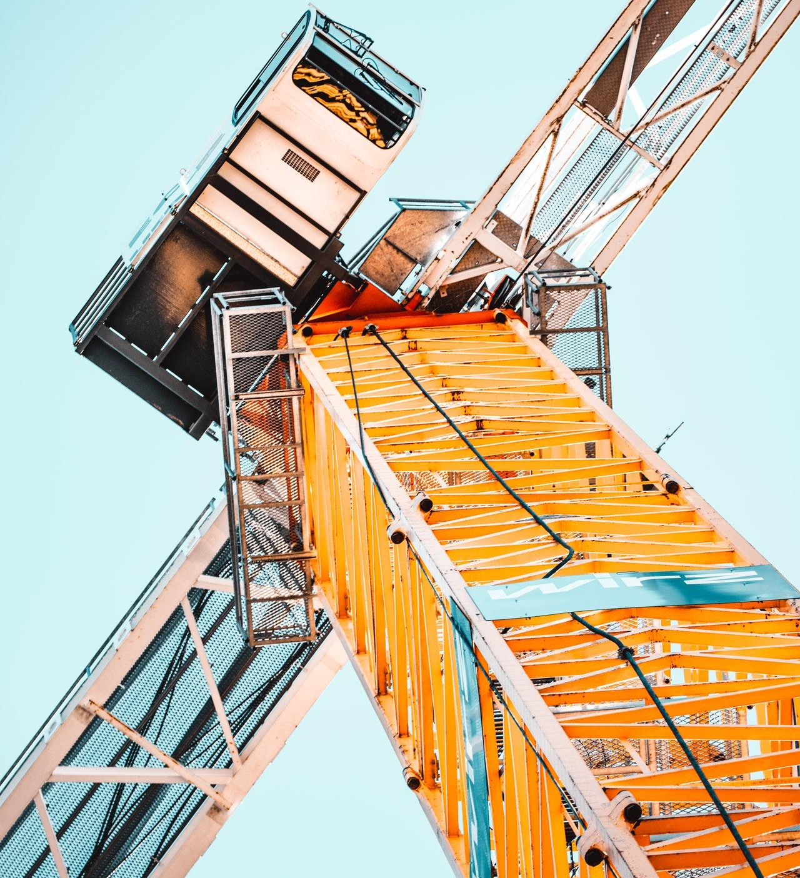
MARTINABERG
Construction

Slide 2
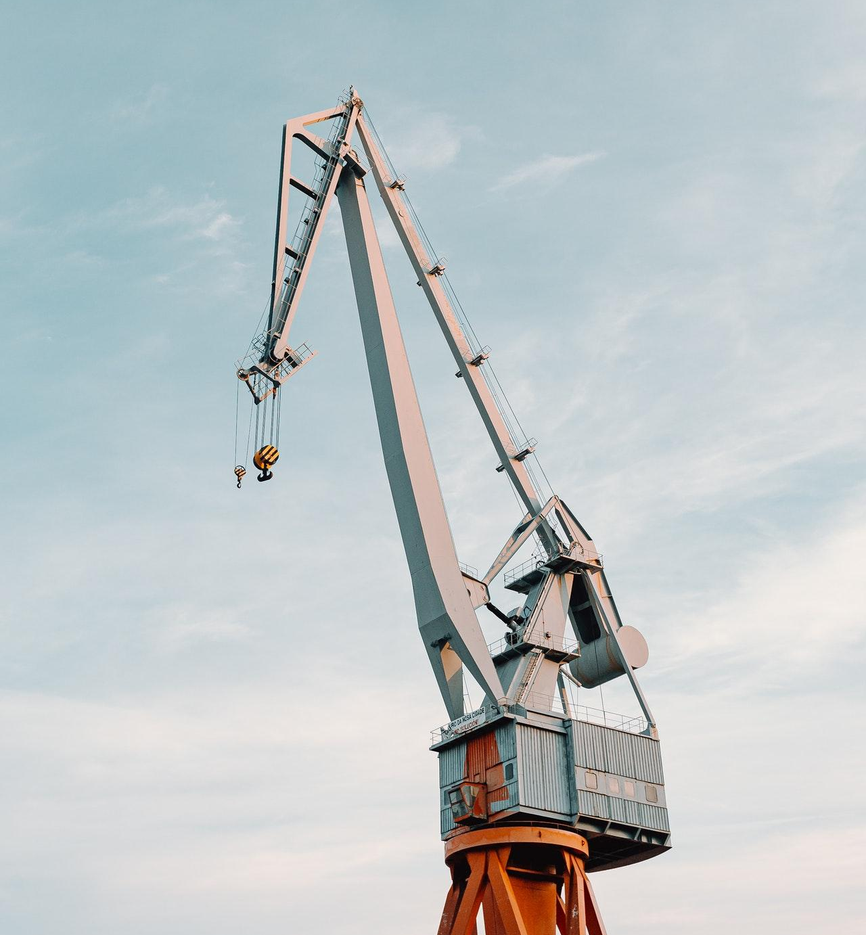
KAMERON GORCZANY
Managing Director
+1 012-345-6789
+1 012-345-6789
example.com
example@mail.com
5703 Rippin Crescent Apt.
85, New Tremaine

