Slide 1
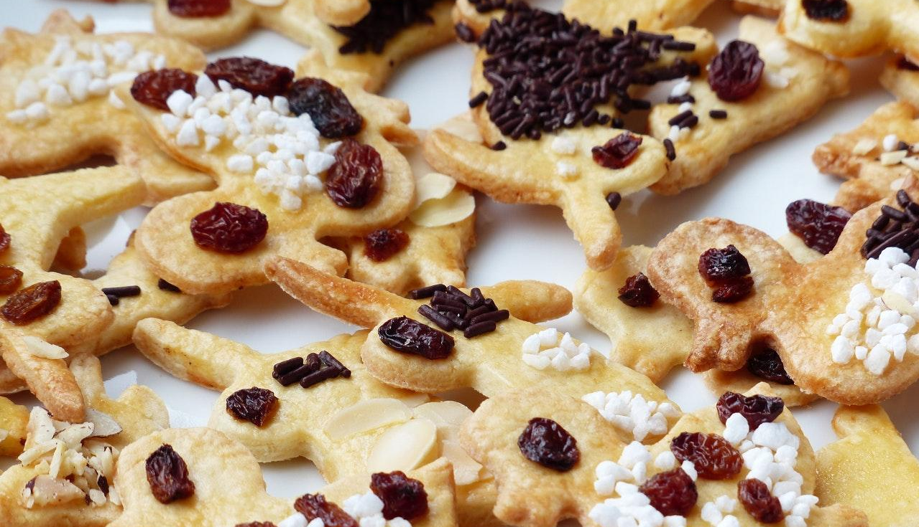
BAKERY
ALWAYS FRESH

Slide 2
BAKERY
ALWAYS FRESH
New York, JS.
(123) 456-7890
Mail@domain.ltd
Domain.ltd

