Slide 1
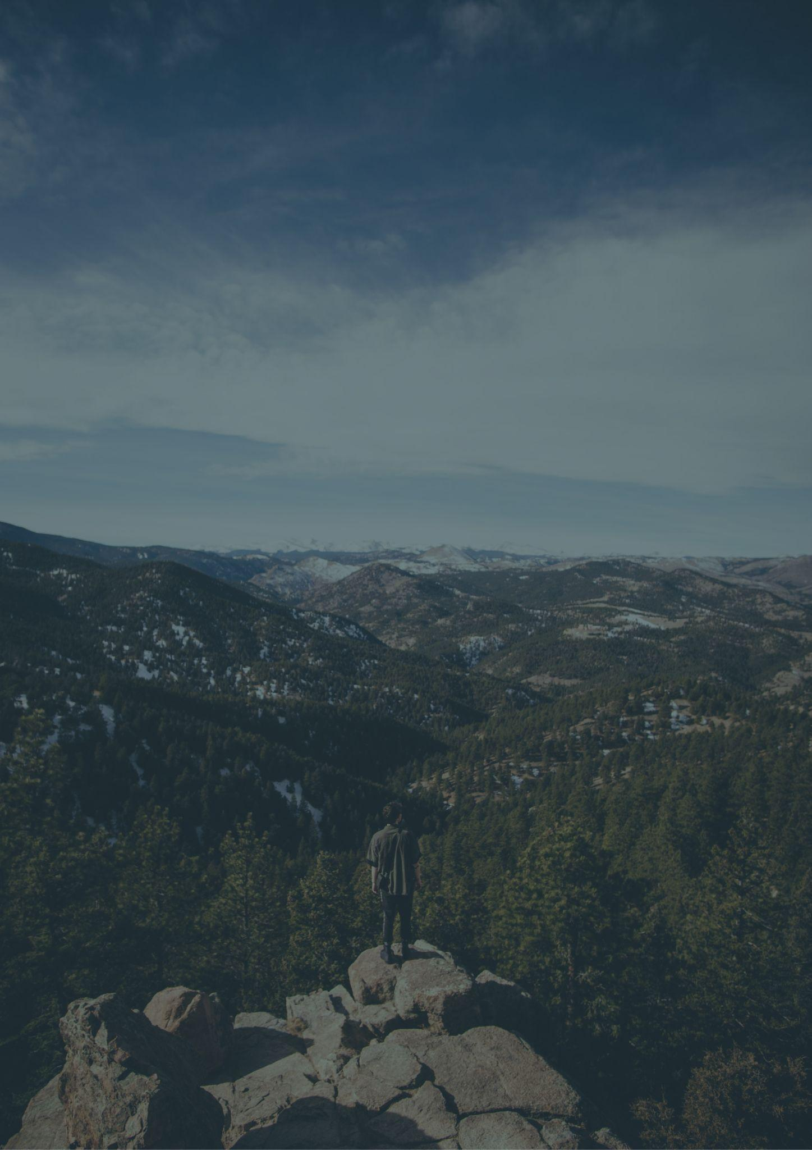
COLORADO
Travel bucket list
ROCKY MOUNTAIN NATIONAL PARK
TELLURIDE SKI RESORT
VAIL AND NEARBY MOUNTAIN
GARDEN OF THE GODS
MESA VERDE NATIONAL PARK
MESA VERDE NATIONAL PARK
BRECKENRIDGE
VAIL SKI RESORT
GARDEN OF THE GODS
BLACK CANYON
TRAIL RIDGE ROAD
DENVER MUSEUM
MAROON BELLS
GREAT SAND DUNES
CHEYENNE MOUNTAIN ZOO
ELITCH GARDENS THEME PARK
MOUNT EVANS SCENIC BYWAY
ROCKY MOUNTAIN
GREAT SAND DUNES PARK
LOST RIVER CAVE
ASPEN
MOUNT EVANS SCENIC BYWAY
COLORADO NATIONAL MONUMENT
BRIDAL VEIL FALLS
DINOSAUR NATIONAL MONUMENT
ROYAL GORGE BRIDGE AND PARK
GLENWOOD SPRINGS
HANGING LAKE
MOUNT EVANS SCENIC BYWAY
BUFFALO BILL MUSEUM

