Slide 1
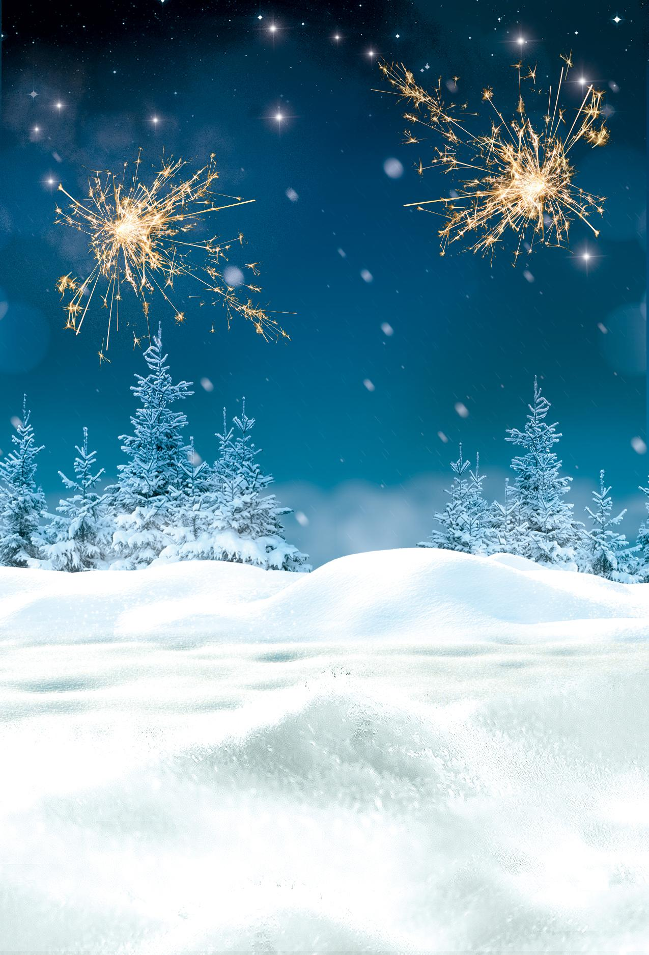


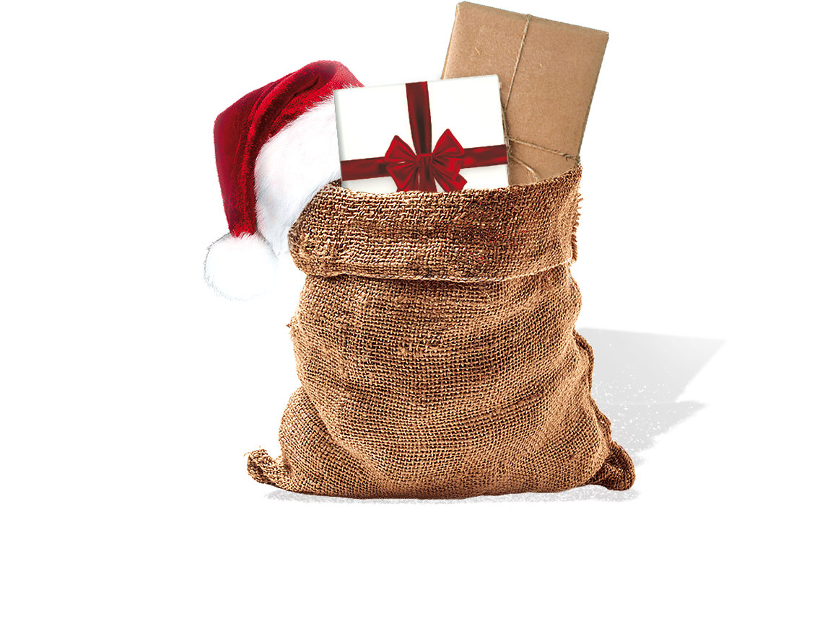
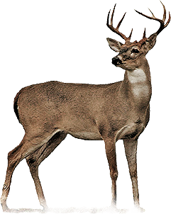
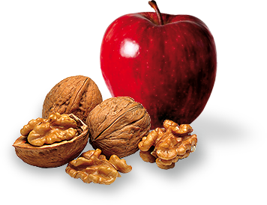

We warmly invite you to our
CHRISTMAS
THURSDAY
DEC 24
2026
Special performance by
DJ MERRY & JOHNNY SNOW
FREE DRINKS FOR GIRLS • DOORS OPEN AT 9 PM • GUEST LIST ONLY
Nightclub Seven // 21 Jump Street, LA // For Reservation Call 123 456 789

