Slide 1
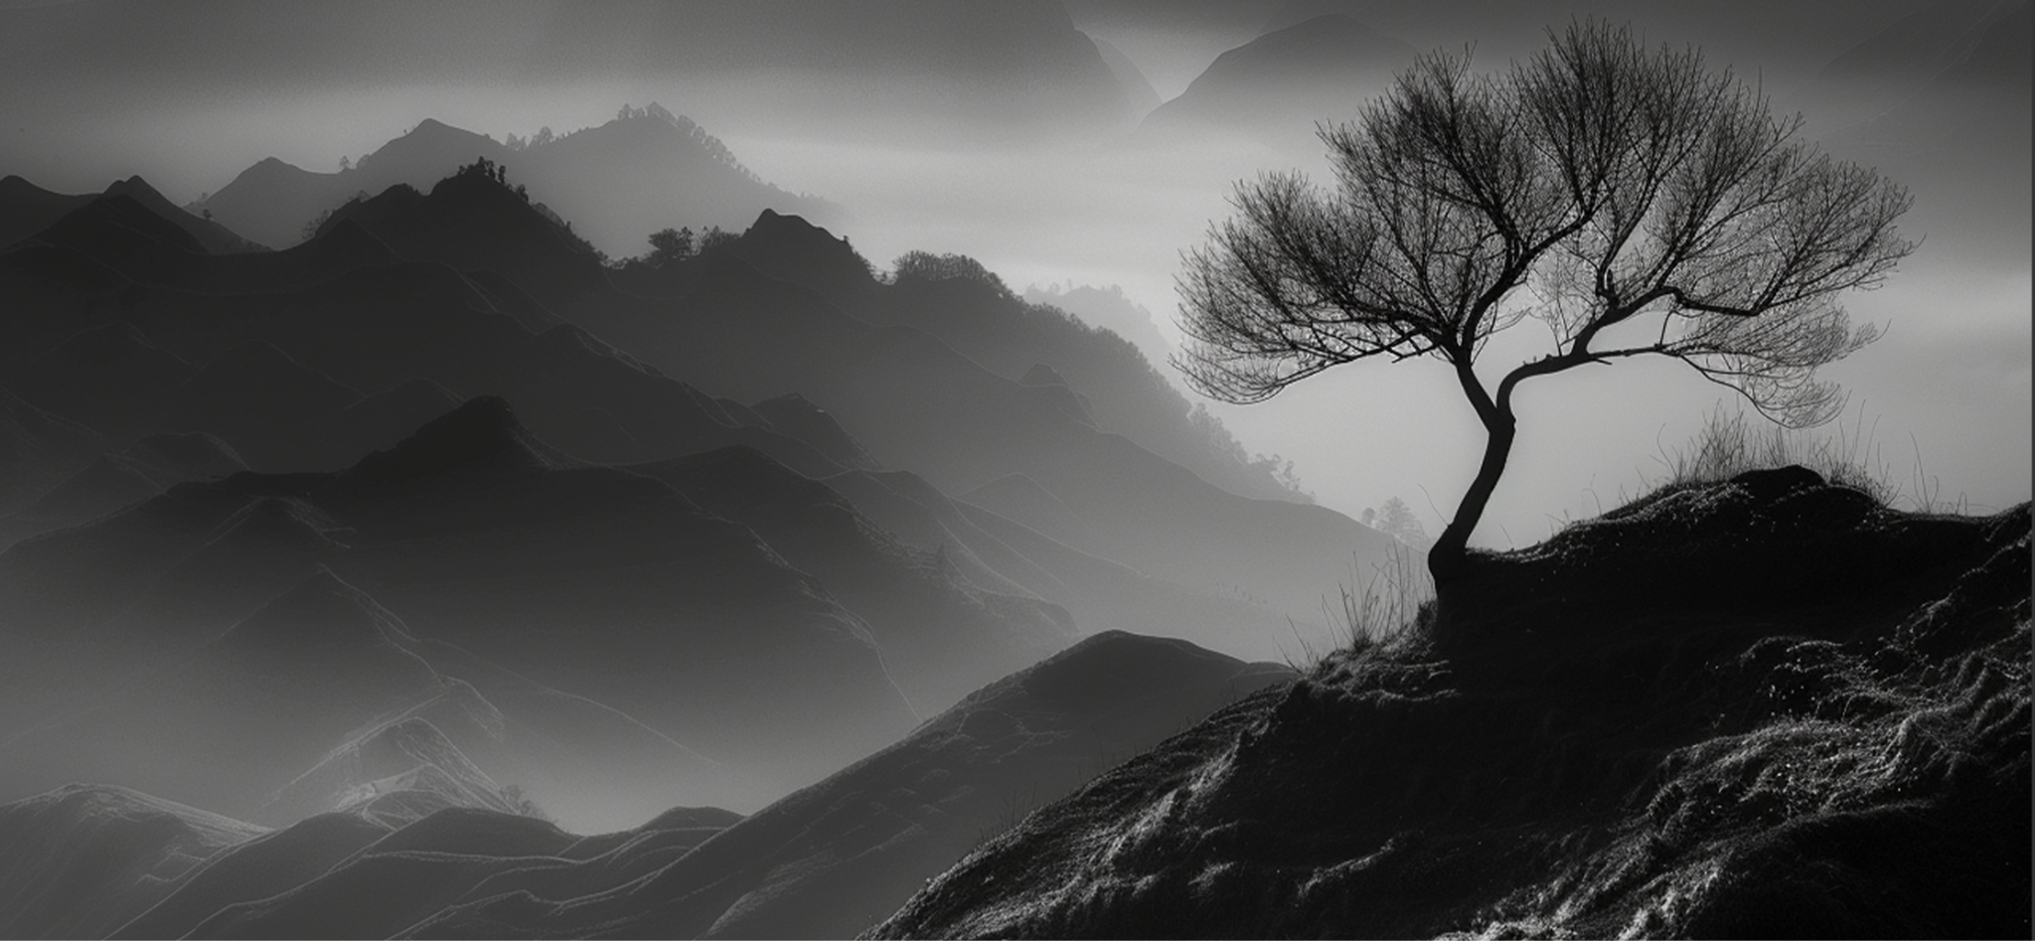
Vol.84
march 12, 2025
The Majestic Mountains
Nature's elegance
"The mountains are calling and I must go." – John Muir
THE MAJESTIC MOUNTAINS
UNIQUE
EXPERIENCE
THE TOWERING PEAKS: NATURE'S GRANDEUR IN FULL DISPLAY
Nestled within the heart of our planet are the breathtaking mountain ranges that inspire awe and wonder. From the snow-capped Himalayas to the rugged Rockies, these natural monuments stand as timeless sentinels of Earth's history. Their lofty heights offer a sanctuary for diverse flora and fauna, creating ecosystems rich with life and beauty.
Nestled within the heart of our planet are the breathtaking mountain ranges that inspire awe and wonder. From the snow-capped Himalayas to the rugged Rockies, these natural monuments stand as timeless sentinels of Earth's history. Their lofty heights offer a sanctuary for diverse flora and fauna, creating ecosystems rich with life and beauty.Nestled within the heart of our planet are the breathtaking mountain ranges that inspire awe and wonder. From the snow-capped Himalayas to the rugged Rockies, these natural monuments stand as timeless sentinels of
Nestled within the heart of our planet are the breathtaking mountain ranges that inspire awe and wonder. From the snow-capped Himalayas to the rugged Rockies, these natural monuments stand as timeless sentinels of Earth's history. Their lofty heights offer a sanctuary for diverse flora and fauna, creating ecosystems rich with life and beauty. Nestled within the heart of our planet are the breathtaking mountain ranges that inspire awe and wonder. From the snow-capped Himalayas to the rugged Rockies, these natural monuments stand as timeless sentinels of Earth's history. Their lofty heights offer a sanctuary for diverse flora and fauna, creating ecosystems rich with life and beauty.Nestled within the heart of our planet are the breathtaking mountain ranges that inspire awe and wonder. From the snow-capped Himalayas to the rugged Rockies, these natural monuments stand as timeless sentinels of Earth's history. Their lofty heights offer a sanctuary.
The allure of the mountains is not just in their imposing presence but also in the serene vistas they provide. Whether you are trekking through the Andes or skiing down the Alps, each mountain range offers a unique experience.
"THE MOUNTAINS ARE CALLING AND I MUST GO."
The allure of the mountains is not just in their imposing presence but also in the serene vistas they provide. Whether you are trekking through the Andes or skiing down the Alps, each mountain range offers a unique experience.

Slide 2
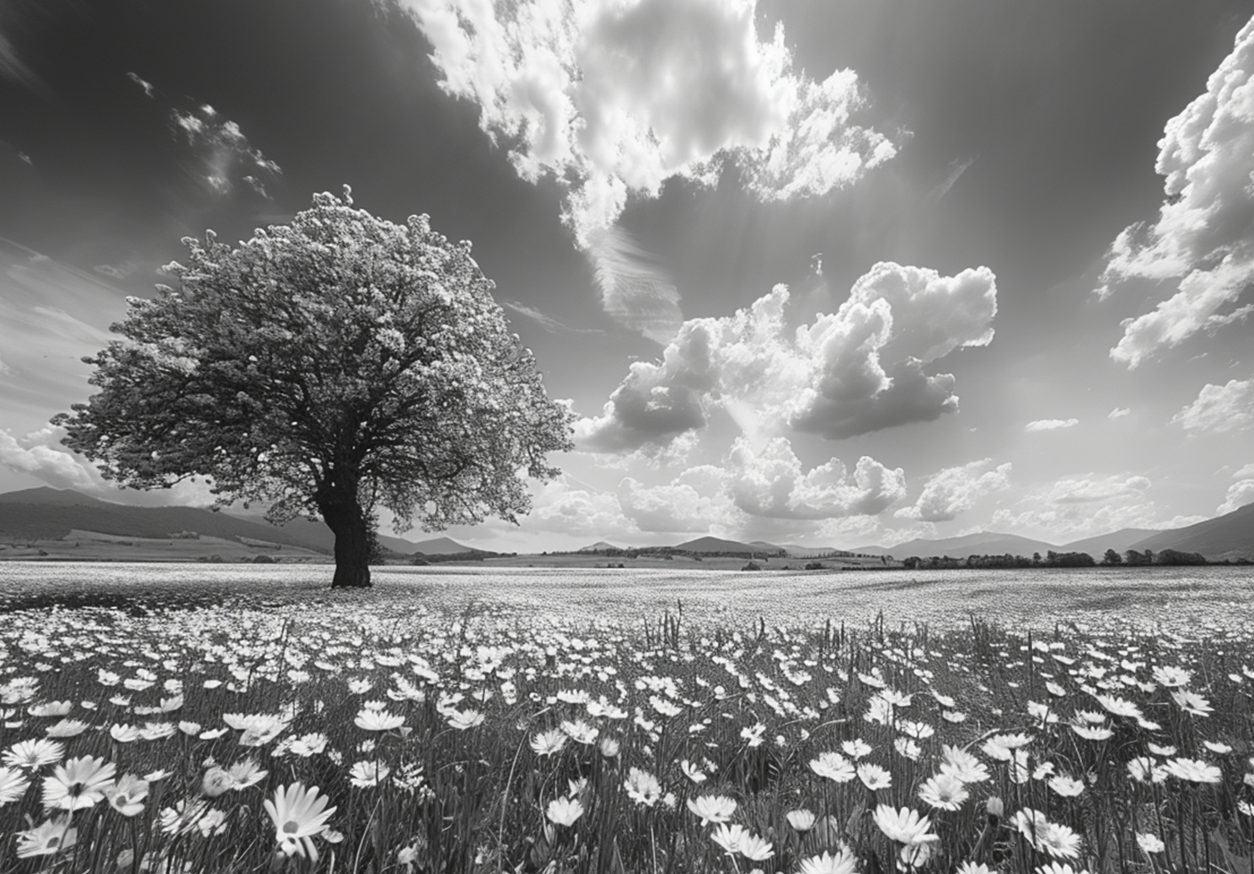
Vol.84
march 12, 2025
The Majestic Mountains
Nature's elegance
THE BLOSSOMING BEAUTY OF MEADOWS
HEADLINE: FIELDS OF DREAMS: THE BLOSSOMING BEAUTY OF MEADOWS
Meadows, with their rolling hills and vibrant carpets of wildflowers, are nature's celebration of life and color. These open fields, whether in the countryside or high alpine regions, burst into bloom with a variety of flora, attracting pollinators like bees and butterflies.
Nestled within the heart of our planet are the breathtaking mountain ranges that inspire awe and wonder. From the snow-capped Himalayas to the rugged Rockies, these natural monuments stand as timeless sentinels of Earth's history. Their lofty heights offer a sanctuary for diverse flora and fauna, creating ecosystems rich with life and beauty.
Nestled within the heart of our planet are the breathtaking mountain ranges that inspire awe and wonder. From the snow-capped Himalayas to the rugged Rockies, these natural monuments stand as timeless sentinels of Earth's history. Their lofty heights offer a sanctuary for diverse flora and fauna, creating ecosystems rich with life and beauty.Nestled within the heart of our planet are the breathtaking mountain ranges that inspire awe and wonder. From the snow-capped Himalayas to the rugged Rockies, these natural monuments stand as timeless sentinels of Earth's history. Their lofty heights offer a sanctuary for diverse flora and fauna, creating ecosystems rich with life and beauty.
"The mountains are calling and I must go." – John Muir
Nestled within the heart of our planet are the breathtaking mountain ranges that inspire awe and wonder. From the snow-capped Himalayas to the rugged Rockies, these natural monuments stand as timeless sentinels of Earth's history. Their lofty heights offer a sanctuary for diverse flora and fauna, creating ecosystems rich with life and beauty.
Nestled within the heart of our planet are the breathtaking mountain ranges that inspire awe and wonder. From the snow-capped Himalayas to the rugged Rockies, these natural monuments stand as timeless sentinels of Earth's history. Himalayas to the rugged Rockies, these natural monuments stand as timeless sentinels of Earth's history.
Their lofty heights offer a sanctuary for diverse flora and fauna, creating ecosystems rich with life and beauty.Nestled within the heart of our planet are the breathtaking mountain ranges that inspire awe and wonder. From the snow-capped Himalayas. Their lofty heights offer a sanctuary for diverse flora and fauna, creating ecosystems rich with life and beauty.
SOIL HEALTH
Pollinator Habitat: Supports bees, butterflies, and other insects.
Soil Health: Prevents erosion and maintains fertility.
Biodiversity: Hosts a variety of plant and animal species.
Nestled within the heart of our planet are the breathtaking mountain ranges that inspire awe and wonder. From the snow-capped Himalayas to the rugged Rockies, these natural monuments stand as timeless sentinels of Earth's history. Their lofty heights offer a sanctuary for diverse flora and fauna, creating ecosystems rich with life and beauty.Nestled within the heart of our planet are the breathtaking mountain ranges that inspire awe and wonder. From the snow-capped Himalayas to the rugged Rockies, these natural monuments stand as timeless sentinels of Earth's history. Their lofty heights offer a sanctuary for diverse flora for diverse flora for diverse flora for diverse for diverse flora for diverse flora flora and fauna, creating ecosystems rich with life and beauty.

Slide 3
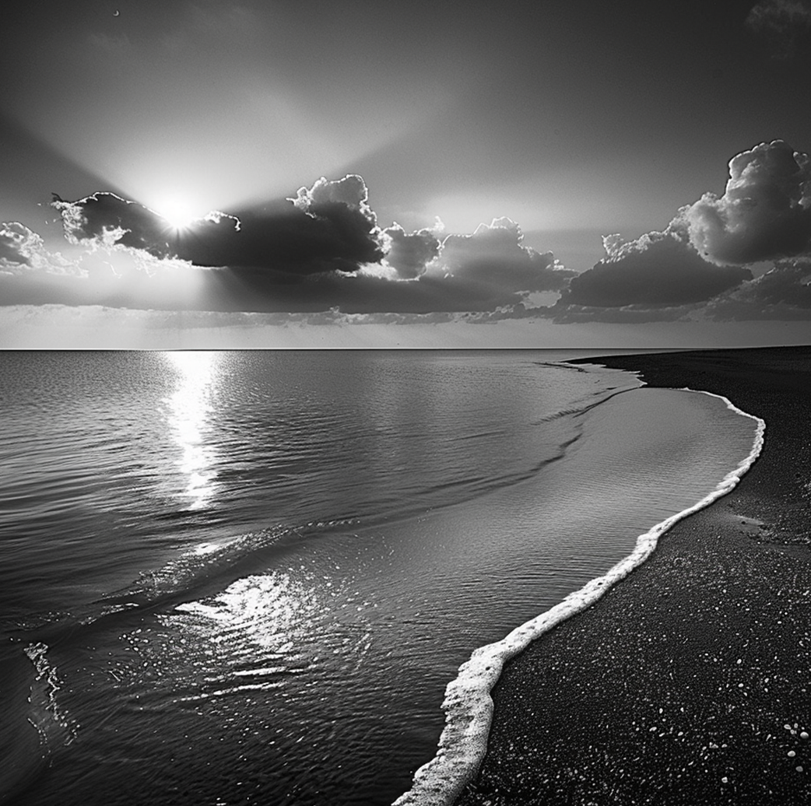
Vol.84
march 12, 2025
The Majestic Mountains
Nature's elegance
THE SERENE SEAS
HEADLINE: OCEAN'S EMBRACE: THE SERENE BEAUTY OF THE SEAS
Meadows, with their rolling hills and vibrant carpets of wildflowers, are nature's celebration of life and color. These open fields, whether in the countryside or high alpine regions, burst into bloom with a variety of flora, attracting pollinators like bees and butterflies.
"FORESTS ARE THE WORLD'S AIR-CONDITIONING
SYSTEM – THE LUNGS OF THE PLANET." – JOHN MUIR
"The mountains are calling and I must go." – John Muir
Forests are the lungs of our planet, teeming with life and mystery. Each tree, each leaf, and every rustle tells a tale of resilience and harmony. The Amazon, often called the Earth's lungs, houses an extraordinary array of species, each playing a vital role in the ecological balance. Forests are the lungs of our planet, teeming with life and mystery. Each tree, each leaf, and every rustle tells a tale of resilience and harmony. The Amazon, often called the Earth's lungs, houses an extraordinary array of species, each playing a vital role in the ecological balance.
Nestled within the heart of our planet are the breathtaking mountain ranges that inspire awe and wonder. From the snow-capped Himalayas to the rugged Rockies, these natural monuments stand as timeless sentinels of Earth's history. Their lofty heights offer a sanctuary for diverse flora and fauna, creating ecosystems rich with life and beauty.From the snow-capped Himalayas to the rugged Rockies, these natural monuments stand as timeless sentinels of Earth's history.
Their lofty heights offer a sanctuary for diverse flora and na, creating ecosystems rich with life and beauty.Nestled within the heart of our planet are the breathtaking mountain ranges that inspire awe and wonder. From the snow-capped Himalayas to the rugged Rockies, these natural monuments stand. Their lofty heights offer lofty heights offer a sanctuary for diverse flora and fauna, creating ecosystems rich with life and beauty. Their lofty heights offer lofty heights offer a sanctuary for diverse.
THE BLOSSOMING
MEADOWS
FIELDS OF DREAMS: THE BLOSSOMING BEAUTY OF MEADOWS
Meadows, with their rolling hills and vibrant carpets of wildflowers, are nature's celebration of life and color. These open fields, whether in the countryside or high alpine regions, burst into bloom with a variety of flora, attracting pollinators like bees and butterflies. Meadows, with their rolling hills and vibrant carpets of wildflowers, are nature's celebration of life and color. These open fields, whether in the countryside or high alpine regions, burst into bloom with a variety of flora, attracting pollinators like bees and butterflies.

Slide 4
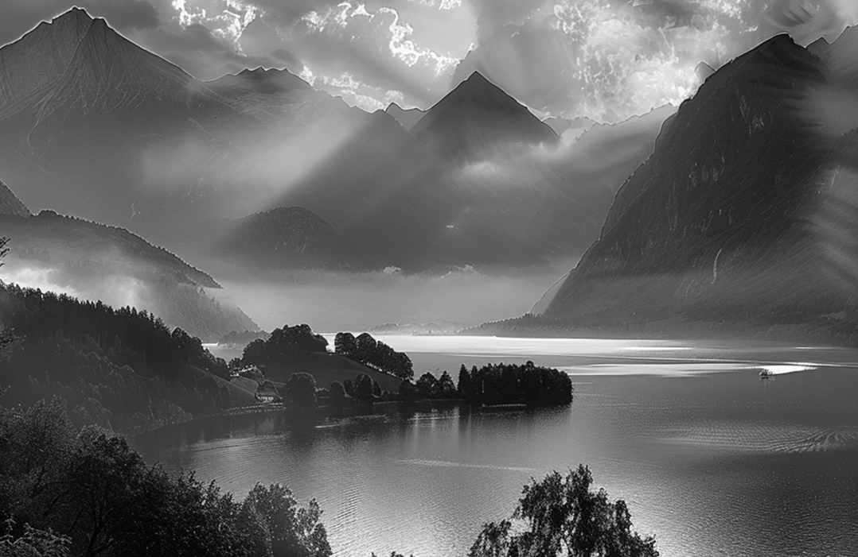
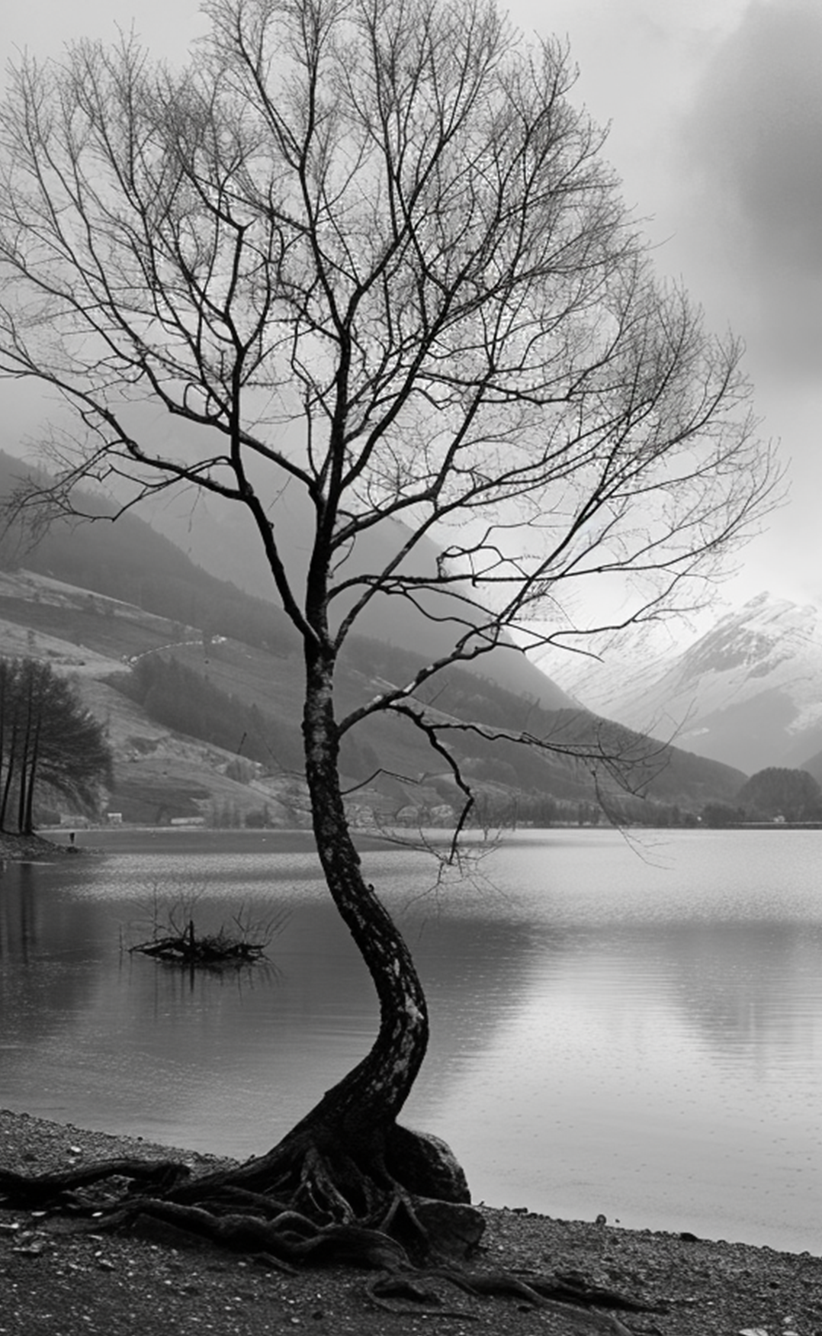
Vol.84
march 12, 2025
The Majestic Mountains
Nature's elegance
THE ENCHANTING
FORESTS
WHISPERS OF THE WOODS: FORESTS OF ENCHANTMENT. MAGIC OF THE CANOPIES AND INTO THE FOREST I GO, TO LOSE.
Forests are the lungs of our planet, teeming with life and mystery. Each tree, each leaf, and every rustle tells a tale of resilience and harmony. The Amazon, often called the Earth's lungs, houses an extraordinary array of species, each playing a vital role in the ecological balance.
"The mountains are calling and I must go." – John Muir
"FORESTS ARE THE WORLD'S AIR-CONDITIONING
SYSTEM – THE LUNGS OF THE PLANET." – JOHN MUIR
Forests are the lungs of our planet, teeming with life and mystery. Each tree, each leaf, and every rustle tells a tale of resilience and harmony. The Amazon, often called the Earth's lungs, houses an extraordinary array of species, each playing a vital role in the ecological balance. Forests are the lungs of our planet, teeming with life and mystery. Each tree, each leaf, and every rustle tells a tale of resilience and harmony. The Amazon, often called the Earth's lungs, houses an extraordinary array of species, each playing a vital role in the ecological balance.
Nestled within the heart of our planet are the breathtaking mountain ranges that inspire awe and wonder. From the snow-capped Himalayas to the rugged Rockies, these natural monuments stand as timeless sentinels of Earth's history. Their lofty heights offer a sanctuary for diverse flora and fauna, creating ecosystems rich with life and beauty.From the snow-capped Himalayas to the rugged Rockies, these natural monuments stand as timeless sentinels of Earth's history. Their lofty heights offer a sanctuary for diverse flora and fauna, creating ecosystems rich with life and beauty.Nestled within the heart of our planet are the breathtaking mountain ranges that inspire awe and wonder. From the snow-capped Himalayas to the rugged Rockies, these natural monuments stand. Their lofty heights offer lofty heights offer a sanctuary for diverse flora and fauna, creating ecosystems rich with life and beauty.
"The mountains are calling and I must go." – John Muir

