Slide 1
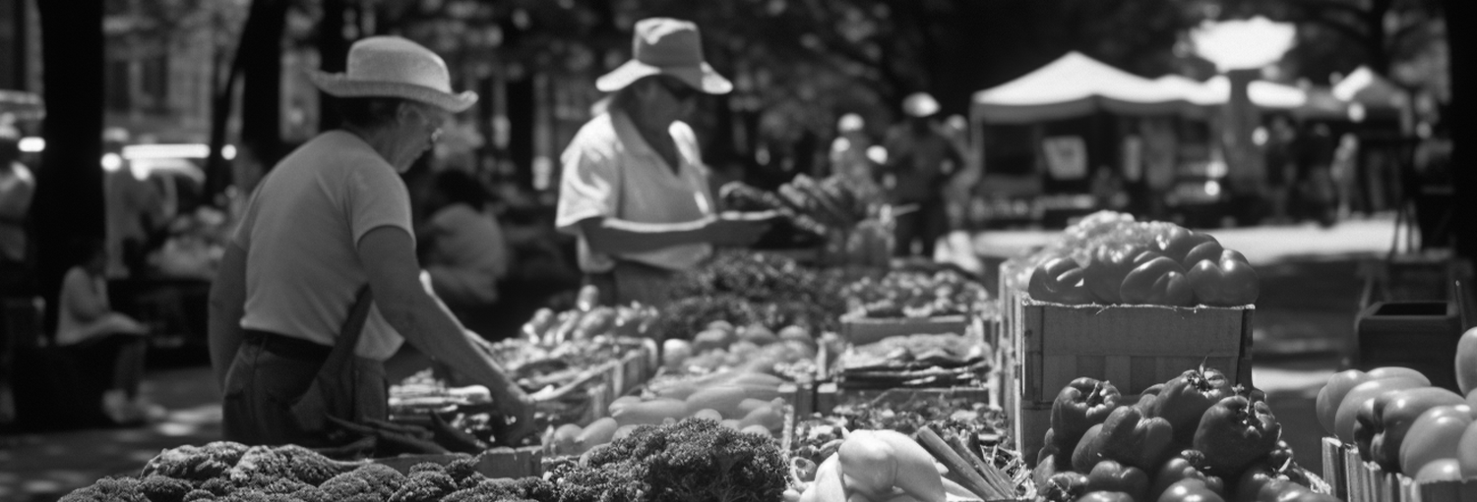
№05
JULY 11, 2024
CITYNEWS
LOCAL HERO SAVES A LITTLE CHILD
Yesterday afternoon, a dramatic rescue took place at Riverside Park
when a local resident saved a young boy
Yesterday afternoon, a dramatic rescue took place at Riverside Park when a local resident, John Doe, saved a young boy from drowning in the river. Doe, a former lifeguard, noticed the child struggling and immediately dove into the water, pulling the child to safety. Paramedics arrived quickly, and the child is expected to make a full recovery.
Doe's quick thinking and bravery have earned him widespread praise from the community. Yesterday afternoon, a dramatic rescue took place at Riverside Park when a local
yesterday afternoon, a dramatic rescue took place at Riverside Park when a local resident, John Doe, saved a young boy from drowning in the river. Doe, a former lifeguard, noticed the child struggling and immediately dove into the water, pulling the child to safety. Paramedics arrived quickly, and the child is expected to make a full recovery. Doe's quick thinking and bravery have earned him widespread praise from the community. Yesterday afternoon, a dramatic rescue took place at Riverside Park when a local resident, John Doe, saved a young boy from drowning in the river.
This is a photo of John Doe in a suit and glasses, at the festival of good mood
CENTRAL PARK
OPENS
A vibrant image of the newly
opened park, bustling with
families and children playing.
A lively scene at the farmers market with colorful stalls, fresh produce, and shoppers mingling.
This weekend, the city celebrated the grand opening of Central Park, attracting thousands of residents with music, food, and family-friendly activities. The park features walking trails, a playground, a pond, and picnic areas. "It's fantastic to have such a beautiful space in the city," said local resident Mark Thompson. The city plans to host various events plans to host various events in the park. The city plans to host various events.
DOWNTOWN FARMERS MARKET
A lively scene at the farmers market with colorful stalls
The Downtown Farmers Market officially kicked off its summer season this Saturday, bringing a burst of color and fresh flavors to the city center. Hundreds of residents flocked to the market, eager to explore the variety of local produce, artisanal goods, and
residents flocked to the market, eager to explore the variety of local produce, artisanal goods, and handmade crafts.
Running every Saturday from 8 AM to 2 PM through September, the market is a beloved tradition that supports. Farmers and small businesses.

Slide 2
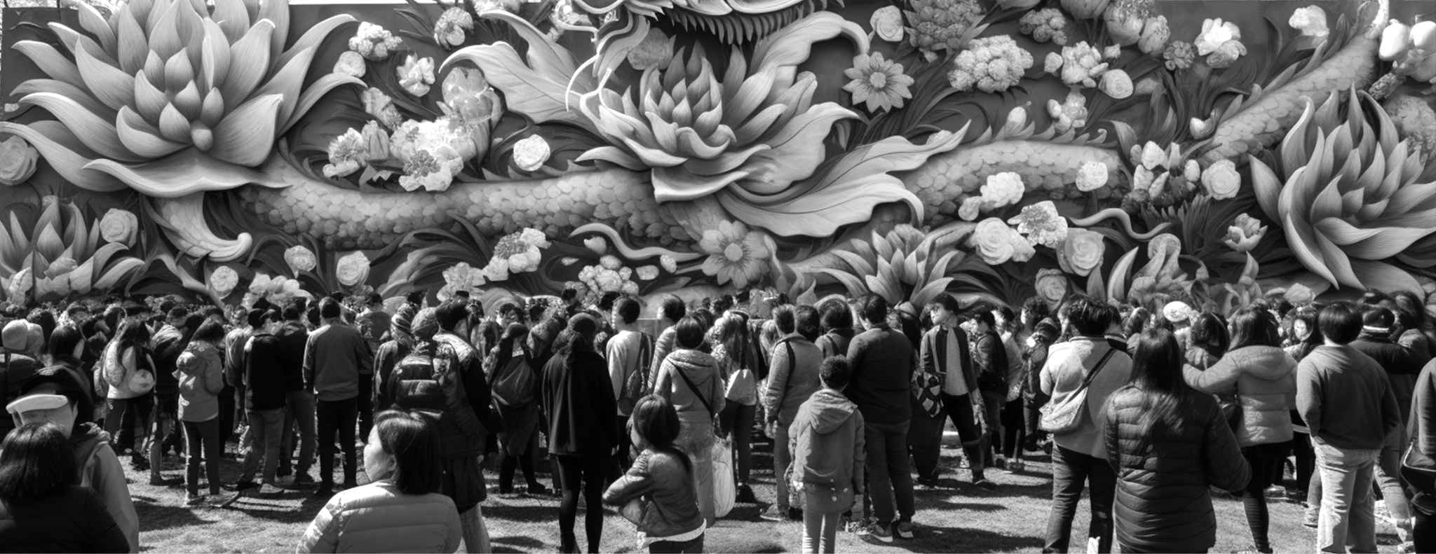
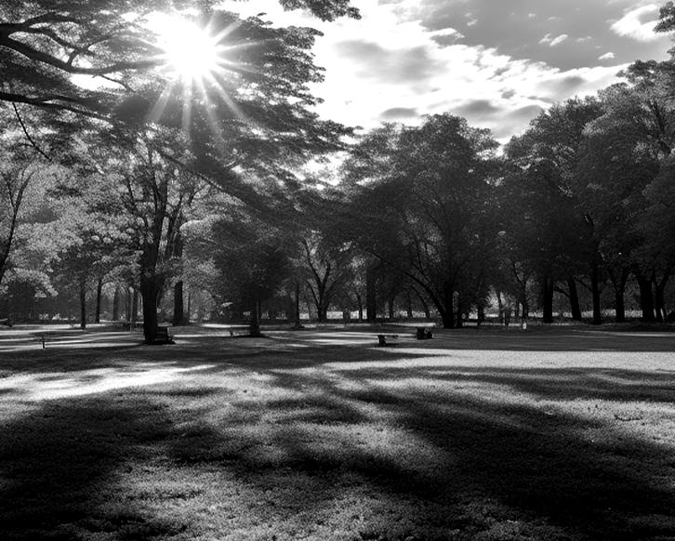
№05
JULY 11, 2024
ANNUAL SPRING FESTIVAL DRAWS RECORD CROWDS
The city's Annual Spring Festival saw its largest turnout ever this past weekend, as residents flocked to the downtown area to enjoy a variety of new attractions and perennial favorites.
A bustling festival scene with colorful booths, a Ferris wheel in the background, and families enjoying the activities.
The city's Annual Spring Festival saw its largest turnout ever this past weekend, as residents flocked to the downtown area to enjoy a variety of new attractions and perennial favorites. The festival, a long-standing tradition, featured a blend of entertainment, food, and community activities that appealed to all ages.
Festival organizer David Miller was thrilled with the event's success. "This year, we really wanted to elevate the festival experience with new attractions and more see so many
see so many people coming together to celebrate the season and enjoy what our city has to offer."Among the new additions was a dazzling light show that illuminated the night sky, drawing gasps and applause from the crowd. The festival also introduced a gourmet food court with local chefs serving up an array of dishes, from classic barbecue to exotic international cuisine.
For the younger attendees, a new adventure zone featured a climbing wall, obstacle courses.
Families enjoyed traditional carnival rides, face painting, and craft stalls, while live music from local bands kept the atmosphere lively throughout the day. A highlight of the festival was the grand parade, featuring elaborate floats, marching bands, and costumed performers that delighted both children and adults. Families enjoyed traditional carnival rides, face painting, and craft stalls, while live music from local bands kept the atmosphere lively throughout the day. A highlight of the festival was the grand parade, featuring elaborate floats.
SPRING CONCERT
"This is such a great way to bring the community together," said attendee Sarah Johnson. "The atmosphere is fantastic, and the music is amazing."
The series will feature weekly performances from a variety of genres, offering something for everyone. Mayor Jane Smith encouraged residents to attend, saying, "It’s a wonderful opportunity to enjoy our beautiful park and support.
Central Park came alive last night
as performance by local favorite,
The Sunsets.
Central Park came alive last night as the city’s Summer Concert Series kicked off with a spectacular performance by local favorite, The Sunsets. Hundreds gathered with picnic blankets and lawn chairs.
lively crowd enjoying a band performance on an outdoor stage in Central Park.

Slide 3
№05
JULY 11, 2024
ART EXHIBITION "VIBRANT VISIONS" OPENS AT CITY GALLERY
City Gallery welcomed art enthusiasts to the opening of its latest exhibition.
Runners crossing the finish line at the charity marathon, with cheering spectators in the background.
City Gallery welcomed enthusiasts to the opening of its latest exhibition, "Vibrant Visions," showcasing the works of emerging local artists. The gallery was abuzz with excitement as attendees admired the diverse collection of paintings, sculptures, and mixed-media pieces. "This exhibition is a celebration of creativity and expression", said gallery curator Emily Chen. "It’s inspiring to see the talent and imagination of our local artists on display."
"Vibrant Visions" features colors, dynamic compositions, and thought-provoking the artists' unique perspectives and artistic journeys.
LOCAL CHARITY MARATHON RAISES
The streets were bustling with energy as runners of all ages.
Charity Marathon, raising funds for the city’s homeless shelter. From seasoned athletes to first-time participants, hundreds joined together for a day of fitness and philanthropy.
"We’re thrilled by the turnout and support for this important cause," said event organizer Lisa Martinez. "The funds raised will make a significant difference in providing shelter and support for those in need in our community." Participants traversed a scenic route through the city, cheered on by enthusiastic supporters lining the streets. Volunteers handed out water and encouragement, while live music and entertainment added to the festive atmosphere.
"I’m proud to a part of something that’s making a positive impact," said marathon runner David Collins. "Knowing that every step I take helps someone in need is incredibly motivating". Thanks to the generosity of sponsors, donors, and participants, the Charity Marathon exceeded its fundraising goal, ensuring vital resources for the homeless shelter. Organizers expressed gratitude to everyone involved and emphasized the importance of community.
"We’re thrilled by the turnout and support for this important cause," said event organizer Lisa Martinez. "The funds raised will make a significant difference in providing shelter and support for those in need in our community."
Participants traversed a scenic route through the city, cheered on by enthusiastic supporters lining the streets. Volunteers handed out water and encouragement, while live music and entertainment added to the festive atmosphere.
"I’m proud to a part of something that’s making a positive impact," said marathon runner David Collins. "Knowing that every step I take helps someone in need is incredibly motivating". Thanks to the generosity of sponsors, donors, and participants, the Charity Marathon exceeded its fundraising goal, ensuring vital resources for the homeless shelter.
Organizers expressed gratitude to everyone involved and emphasized the importance of community solidarity in importance of community solidarity in addressing homelessness.
"This exhibition is a celebration of creativity and expression",

Slide 4
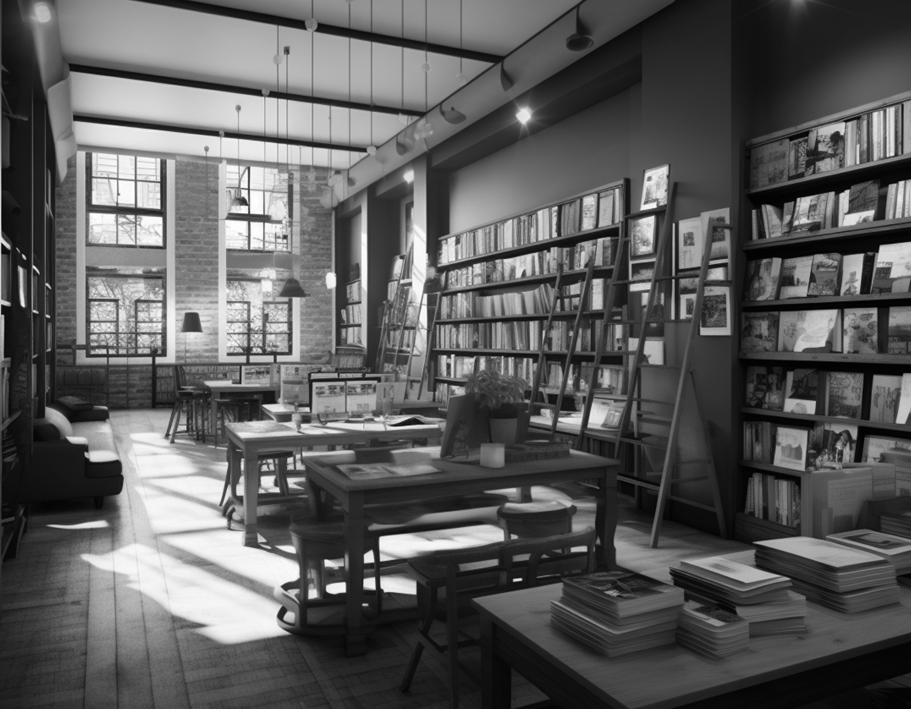
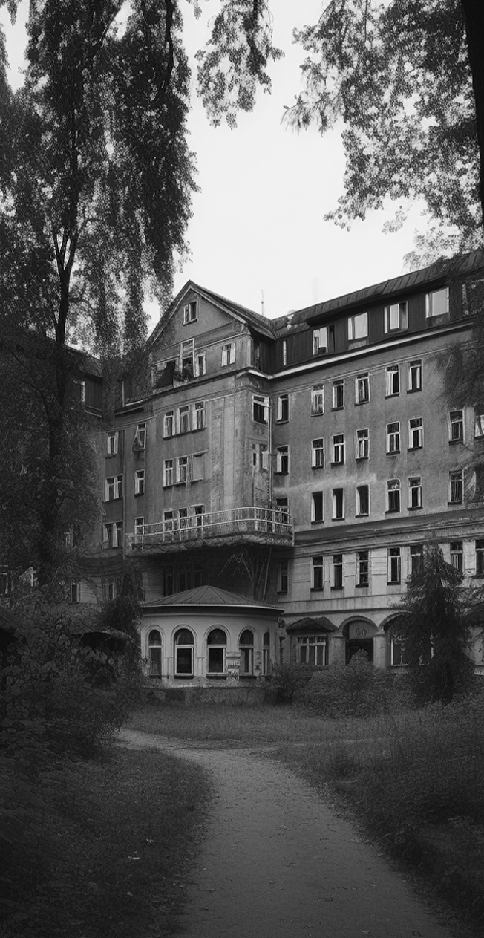
№05
JULY 11, 2024
CITY LIBRARY
RENOVATION
The city’s library reopened this week after a year-long renovation, revealing a sleek.
The city’s main library reopened this week after a year-long renovation, revealing a sleek, modern space equipped with the latest technology. The grand reopening ceremony drew an enthusiastic crowd of book lovers, students, and tech enthusiasts eager to explore the updated facility.
Library Director Linda Walker led the ribbon-cutting ceremony, expressing her excitement about the transformation. "This renovation represents a significant investment in our community’s future," she said. "Our new facilities and resources will provide unparalleled access to information and technology, ensuring that everyone can benefit from the digital age."
The renovated library library boasts a variety of high-tech features, including interactive touch-screen kiosks for information and book searches, a state-of-the-art digital media lab, and an extensive collection of e-books and audiobooks. The new design also includes more collaborative workspaces, comfortable reading areas, and a dedicated children's section with interactive learning tools.
One of the standout features is the Innovation Hub, which houses 3D printers, virtual reality headsets, and other cutting-edge technologies. This space is designed to foster creativity and learning, offering workshops offering workshops and hands-on experiences for all ages and hands-on experiences for all ages.
A modern, sleek library interior with new high-tech features, including touch-screen information kiosks and a digital media section
LOCAL HIGH SCHOOL LAUNCHES
Enthusiastic students engaged in a hands-on science experiment, surrounded by high-tech lab equipment and their teacher guiding.
This week, Jefferson High School unveiled its groundbreaking STEM (Science, Technology, Engineering, and Mathematics) program, aimed at preparing students for the fast-evolving demands of the 21st-century job market. The launch event featured demonstrations, student presentations, and remarks from educators and industry professionals.
Principal Karen Lee introduced the program, emphasizing its potential to transform students' educational experiences. "Our new STEM program is designed to inspire and equip our students with the critical skills and knowledge they need to succeed in today's technology-driven world," she said. We are committed to providing opportunities open. Doors to future careers in STEM fields." The program includes state-of-the-art.
Enthusiastic students engaged in a hands-on science experiment.

