Slide 1
Kimberly Pagac
YOUR PASTOR

Slide 2
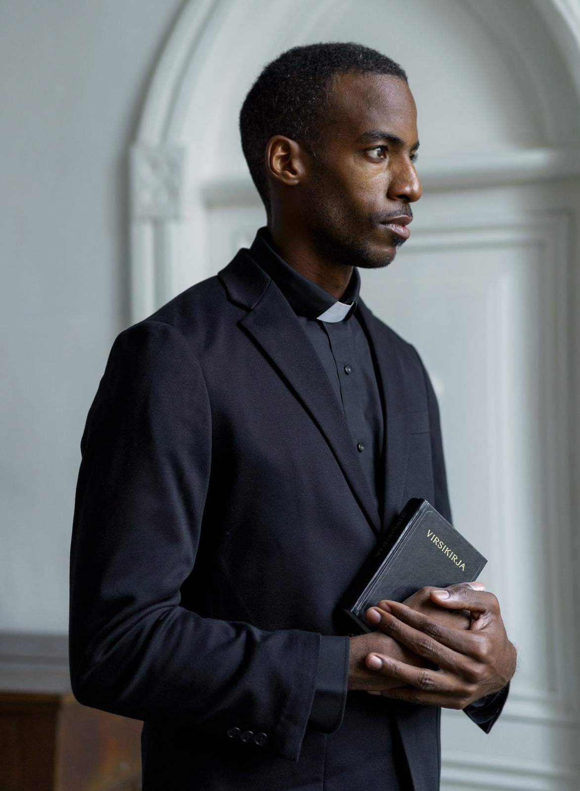
Pastor Kimberly Pagac
Church office: 012-345-6789
Personal number: 012-345-6789
New Tremaine Church
Address: 5703 Rippin Crescent Apt.
85, New Tremaine
E-mail: example@mail, comexample.com
Brothers and sisters let's pray together

