Slide 1
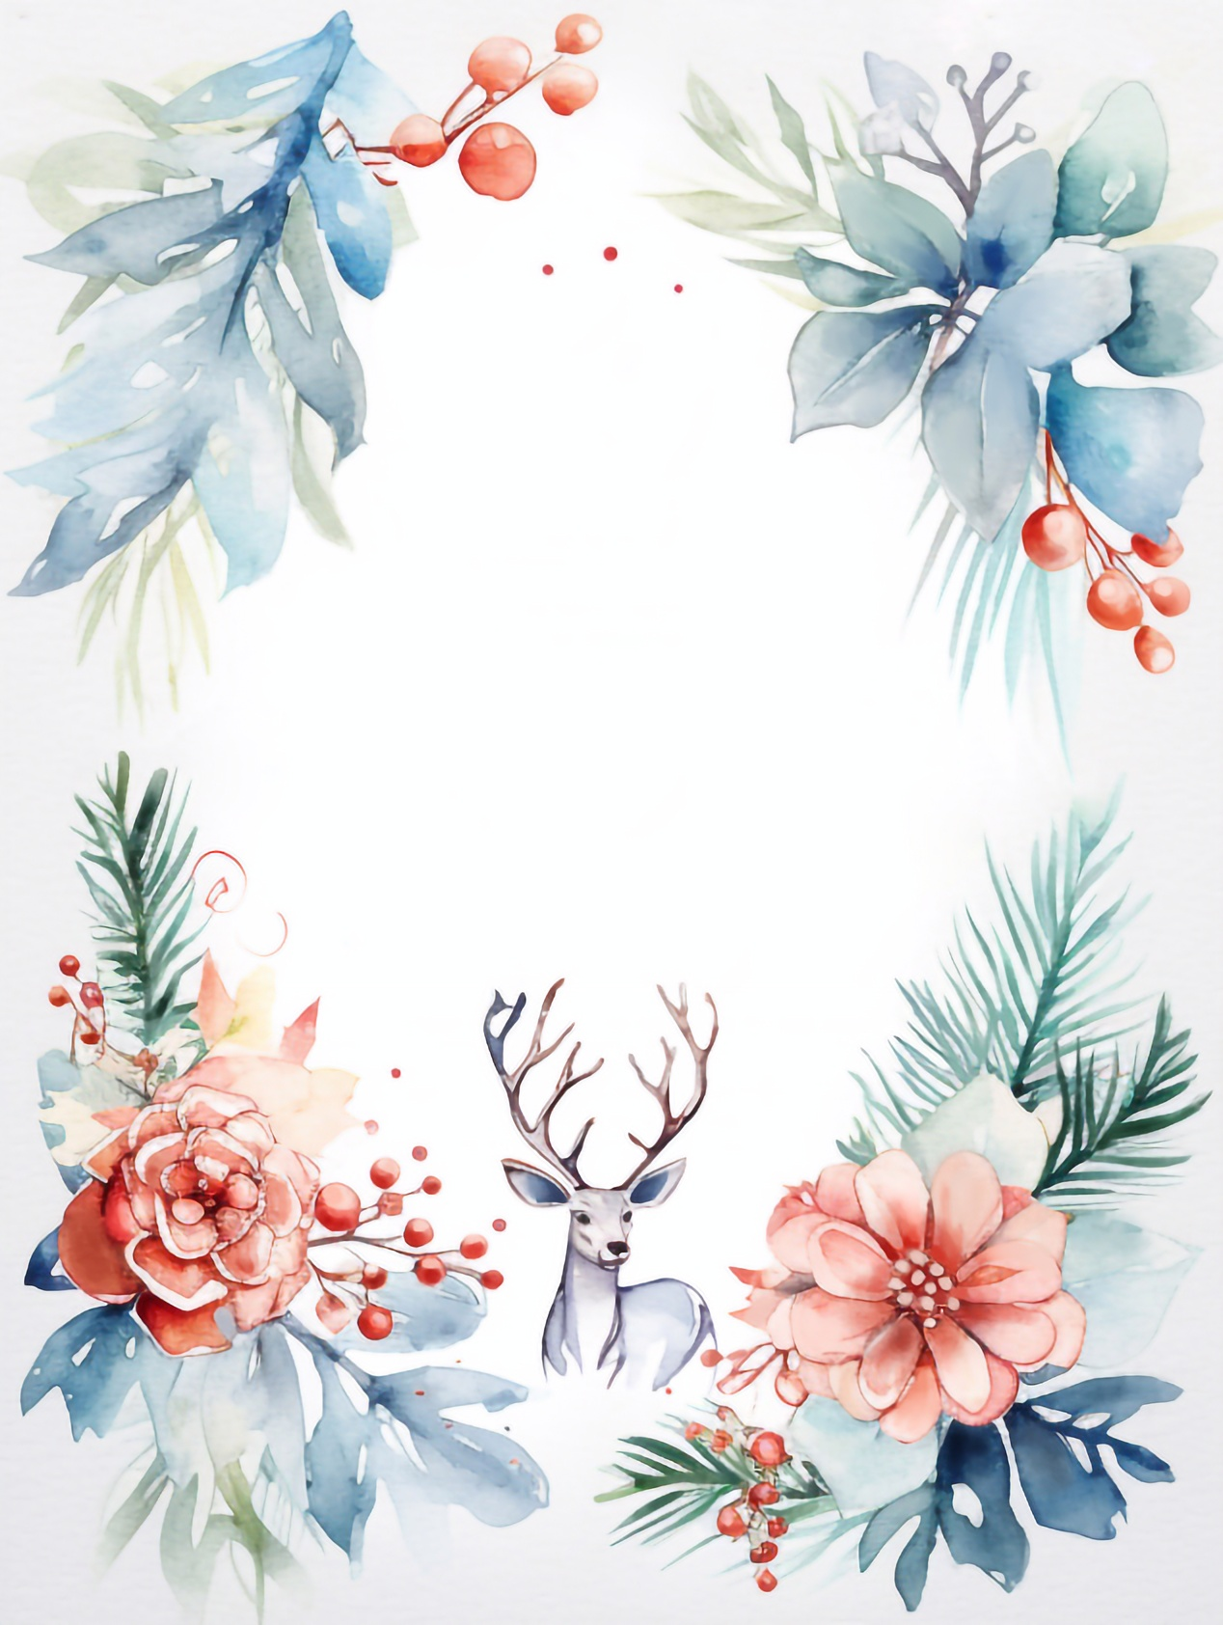

Please join us for a
Christmas Party
DEC 15
5:00 PM
The Dean’s Residence
545 Flora Lane - Santa Barbara, CA
RSVP to Jen by 12.01 at 831.555.1234

