Slide 1
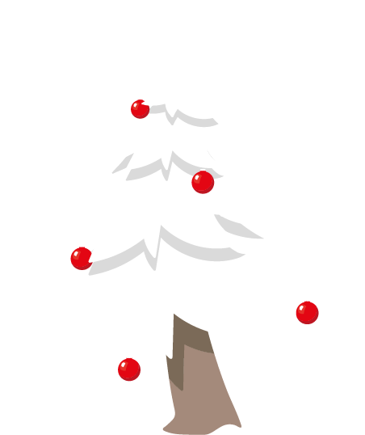
Merry
Christmas
Merry
Christmas

