Slide 1
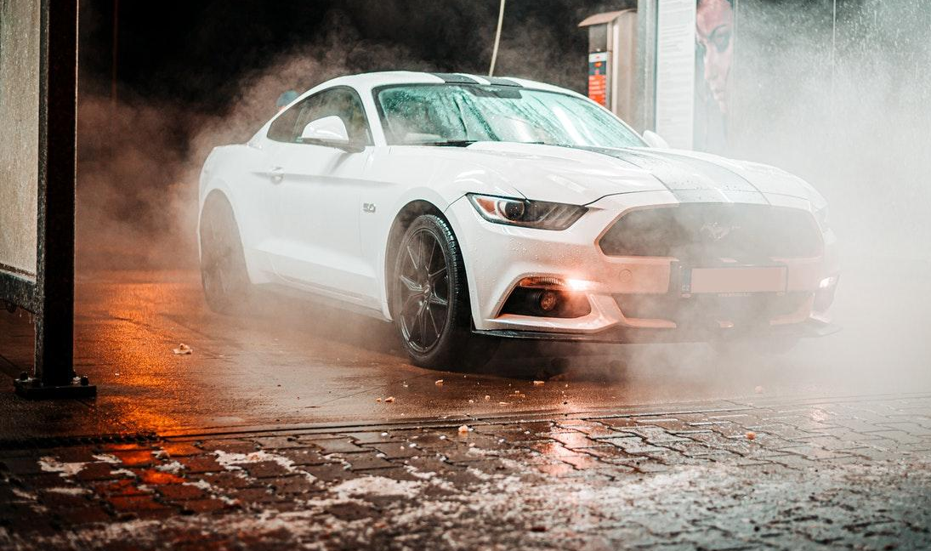
car wash
24/7
5703 Rippin Crescent Apt.
85, New Tremaine
+1 012-345-6789
example.com

Slide 2
Henry Rau
Manager`s Assistant
5703 Rippin Crescent Apt.
85, New Tremaine
+1 012-345-6789
+1 987-654-3210
example.com
example@mail.com

