Slide 1
COMPANY NAME
Your Slogan
Business
Plan
Prepared
01/01/2028
Contact Name
Phone Number
Position in Company
Email Address
Website: www.companyname.ltd
Street Address
City, State and Zip

Slide 2
Table of Contents
1.
Executive Summary
Page 3
2.
Financial Highlights
Page 4
3.
Financing Requirements
Page 5
4.
Company Overview
Page 6
5.
Market Analysis
Page 9
6.
Execution
Page 12
7.
Financial Plan
Page 22
8.
Appendix
Page 30
Page 2

Slide 3
Executive Summary
The Executive Summary is the most important section of your business plan, as it provides a concise overview of your entire business. It should capture the reader’s attention and summarize
key aspects of your plan in one to two pages.
What to Include:
1.
Business Name & Description – Briefly introduce your business,
including the name, industry, and what it does.
2.
Mission Statement – A short and impactful statement describing your
business’s purpose and values.
3.
Business Model – Explain how your company operates and
generates revenue.
4.
Market Opportunity – Summarize your target market, customer needs,
and competitive advantage.
5.
Products or Services – Highlight what you offer and how it benefits
your customers.
6.
Financial Summary – Provide key financial projections, such as expected revenue, expenses, and profitability.
7.
Funding Requirements (if applicable) – If you are seeking investment or loans, state how much funding is needed and how it will be used.
Page 3

Slide 4
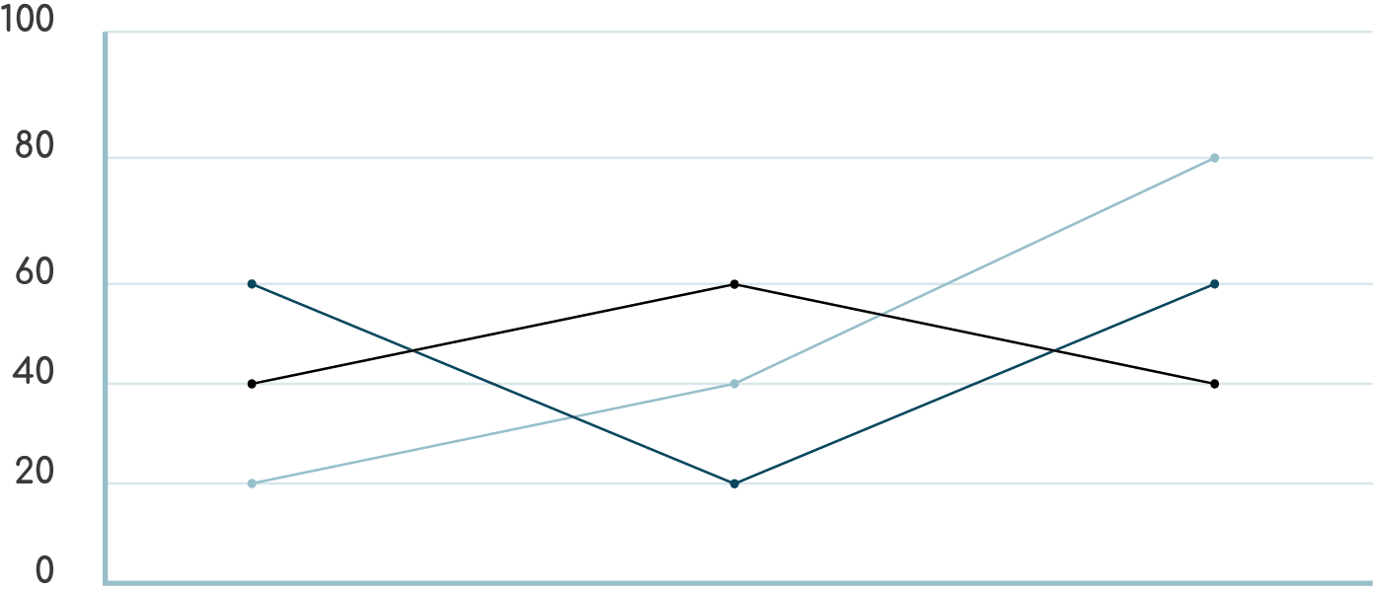
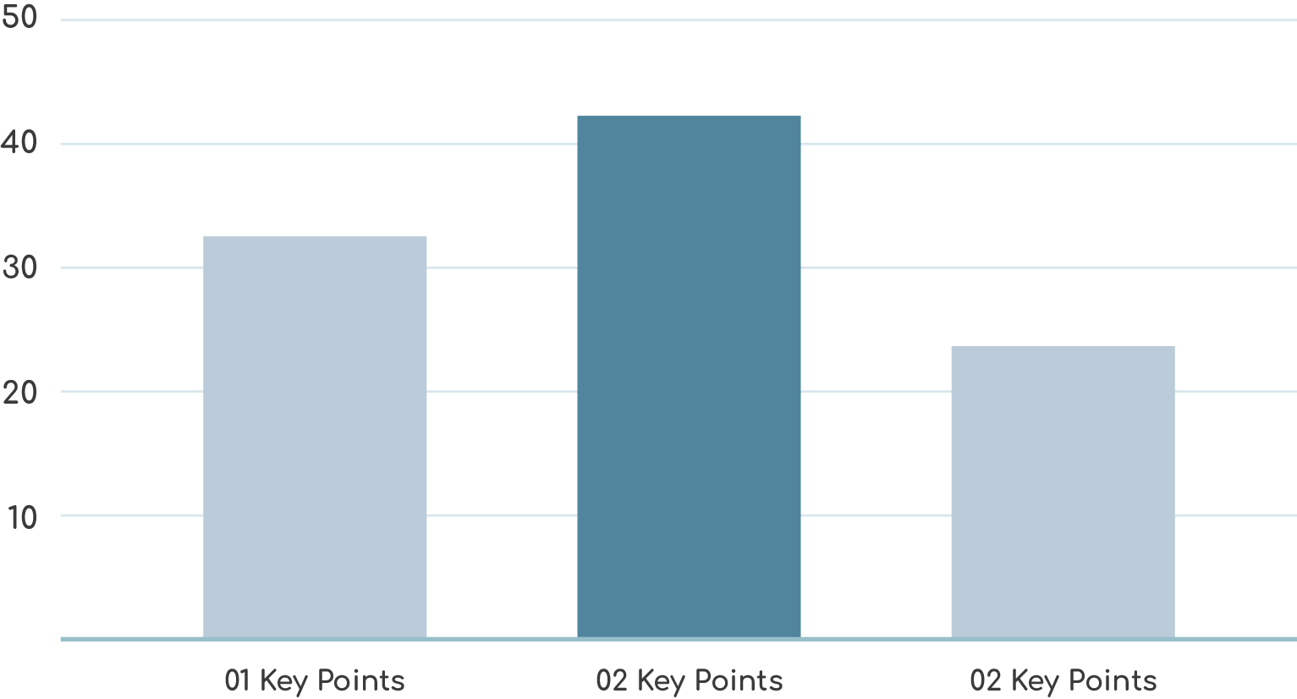
2. Financial Highlights
Add your own charts displaying your key financial data.
Add your own charts displaying your key financial data.
Page 4

Slide 5
3. Financing Requirements
If applicable:
If you seek to raise money for your business, include a concise
summary of what you need funding for.
Page 5

Slide 6
4. Company Overview
Provide a description of the overall nature of your business
and the industry it operates in.
What to Include:
1.
Details like industry trends – Summarize the current state of your industry, including market size and recent growth trends.
2.
Demographics – Define your ideal customers based on age, income level, location, behavior, and preferences.
3.
Details like industry trends – Summarize the current state of your industry, including market size and recent growth trends.
4.
Details like industry trends – Summarize the current state of your industry, including market size and recent growth trends.
Page 6

Slide 7
4.1 Your Team
Detail the name, role, and relevant experience of each key
team member.
[Full Name]
Position: [Job Title]
Experience & Background:
[Summarize relevant professional experience, past roles, and achievements.]
[Highlight key skills and expertise relevant to their role.]
[Mention any notable companies they worked for previously.]
[Full Name]
Position: [Job Title]
Experience & Background:
[Summarize relevant professional experience, past roles, and achievements.]
[Highlight key skills and expertise relevant to their role.]
[Mention any notable companies they worked for previously.]
[Full Name]
Position: [Job Title]
Experience & Background:
[Summarize relevant professional experience, past roles, and achievements.]
[Highlight key skills and expertise relevant to their role.]
[Mention any notable companies they worked for previously.]
Page 7

Slide 8
4.2 Advisory Board
Add If required.
Introduction – Briefly explain why the advisory board was formed and how it contributes to business success
Board Members' Profiles – For each advisor, include
Full Name & Title
Area of Expertise (e.g., Finance, Technology, Marketing)
Relevant Experience (e.g., former CEO of [Company Name], 20+ years in [Industry])
Key Contributions (e.g., provides financial strategy, connects with
investors)
Full Name & Title
Area of Expertise (e.g., Finance, Technology, Marketing)
Relevant Experience (e.g., former CEO of [Company Name], 20+ years in [Industry])
Key Contributions (e.g., provides financial strategy, connects with
investors)
Page 8

Slide 9
5. Market Analysis
5.1 Problem & Solution
5.1.1 The Problem
Describe the core issue your target market faces.
Use data, research, or real-world examples to validate the problem.
Explain how this problem impacts customers, businesses, or the industry.
Address gaps in existing solutions—why are current alternatives insufficient?
5.1.2 Our Solution
Introduce your product or service as the solution to the identified problem.
Highlight the key features and benefits that make your solution effective.
Explain how your business differentiates itself from competitors.
Provide a short, compelling value proposition.
Page 9

Slide 10
5.2 Target Market
5.2.1 Market Size
Total Addressable Market (TAM): The total demand for your product/service globally or nationwide.
Serviceable Available Market (SAM): The portion of TAM that your business can realistically serve based on geography, industry, or other limitations.
Serviceable Obtainable Market (SOM): The share of SAM that your business expects to capture in the short term.
Use statistics, industry reports, and market research to justify your numbers.
5.2.2 Segment
Define your key customer groups based on relevant criteria:
Demographics (age, gender, income, education, etc.)
Geographics (urban, rural, international markets)
Psychographics (lifestyle, values, interests)
Behavioral Factors (buying habits, brand loyalty, product usage)
Explain why these segments need your product and how they interact with your industry.
If applicable, list multiple segments and their unique needs.
Page 10

Slide 11
5.3 Competition
5.3.1 Current Alternatives Target Buyers Are Using
Identify the main competitors in your industry.
Describe the products or services they offer.
Explain how customers currently solve their problem without your solution (e.g., using manual processes, outdated software, or competing products).
Highlight strengths and weaknesses of these alternatives (e.g., high cost, complexity, lack of key features).
5.3.2 Our Competitive Advantages
Explain why your product/service is better than existing alternatives.
Highlight key differentiators, such as:
Unique Features (e.g., AI automation, seamless integrations, real-time insights)
Pricing Advantage (e.g., more affordable, flexible subscription plans)
Ease of Use (e.g., intuitive interface, no need for technical expertise)
Customer Support & Service (e.g., 24/7 support, personalized
onboarding)
Technology & Innovation (e.g., proprietary algorithms, cloud-based
solutions)
Provide a comparison table if needed.
Page 11

Slide 12
6. Execution
6.1 Product or Service Offerings
6.1.1 Product or Service
Clearly describe what your product or service is and its main purpose.
Explain how it works and what problem it solves.
Mention any key features or benefits that differentiate it from alternatives.
If applicable, outline different variations or packages offered.
6.1.2 Unique Selling Proposition (USP)
Explain what makes your product/service unique compared to competitors.
Highlight any innovative technology, superior quality, affordability,
or exclusive features.
Show how your USP aligns with customer needs.
Page 12

Slide 13
6.2 Sales & Marketing Plan
6.2.1 Marketing Plan
6.2.2 Target Audience & Positioning
Define your ideal customer profile (age, location, income, behavior).
Explain your brand positioning—how you want customers to perceive your product/service.
6.2.3 Marketing Strategies
Digital Marketing: SEO, content marketing, social media, email campaigns
Paid Advertising: Google Ads, Facebook Ads, influencer marketing
Public Relations: Press releases, partnerships, sponsorships
Offline Marketing: Networking events, trade shows, flyers
Page 13

Slide 14
6.3.1 Sales Plan
6.3.2 Sales Process
Describe how leads are converted into paying customers.
Outline key sales channels (e.g., online store, direct sales team, resellers).
6.3.3 Pricing & Revenue Model
Explain your pricing strategy (subscription, one-time purchase, freemium).
Highlight any discounts, seasonal promotions, or package deals.
Page 14

Slide 15
6.3.4 Sales Goals & Metrics
Set clear revenue goals (e.g., $500K in the first year).
Define key performance indicators (KPIs) such as conversion rates, customer acquisition cost, and retention rates.
6.3.5 Customer Retention & Loyalty
Explain how you will keep customers engaged and increase their lifetime value.
Consider loyalty programs, referral incentives, personalized offers.
Page 15

Slide 16
6.4 Operations
6.4.1 Business Location(s)
Specify the primary location of your business (headquarters, office, retail store, warehouse, etc.).
Include details such as address, size, ownership status (leased/owned), and why this location was chosen.
If your business operates remotely or online, explain how it is structured.
6.4.2 Facilities & Infrastructure
Describe the key facilities your business needs to operate efficiently
(e.g., offices, manufacturing plants, co-working spaces).
Mention any specialized equipment, production units, or technology
infrastructure required.
If applicable, explain how the facility supports business growth (e.g., scalability, logistics, cost-efficiency).
Page 16

Slide 17
6.4.3 Future Expansion Plans (if applicable)
Outline any planned expansions, new locations, or facility upgrades.
Mention timelines and investment requirements for these expansions.
6.5 Technology Used to Operate Business
6.5.1 Core Technology & Infrastructure
Describe the main technology that powers your business operations.
Highlight any proprietary software, cloud solutions, or automation tools.
Explain how these technologies improve efficiency, scalability, and cost-effectiveness.
Page 17

Slide 18
6.5.2 Software & Tools
List the key software solutions used for daily operations.
Categorize them by function:
Customer Relationship Management (CRM): HubSpot, Salesforce
Accounting & Finance: QuickBooks, Xero
Project Management: Trello, Asana
Marketing & Analytics: Google Analytics, Mailchimp
E-commerce & Payment Processing: Shopify, Stripe, PayPal
6.5.3 Cybersecurity & Data Protection
Explain how your business secures customer data and protects against cyber threats.
Mention encryption methods, compliance standards (GDPR, CCPA), and backup systems.
Page 18

Slide 19
6. 6 Equipment & Tools Needed to Operate Business
6.6.1 Essential Equipment & Tools
List the key equipment, machinery, or tools required for daily operations.
Categorize them based on business function:
Office & Administrative Tools: Computers, printers, office furniture
Production Equipment: Manufacturing machines, 3D printers, packaging tools
IT & Software Tools: Servers, networking devices, cloud storage
Customer Support & Communication: Call center systems, VoIP, chatbots
6.6.2 Cost & Procurement Plan
Describe the key facilities your business needs to operate efficiently
(e.g., offices, manufacturing plants, co-working spaces).
Mention any specialized equipment, production units, or technology
infrastructure required.
If applicable, explain how the facility supports business growth (e.g., scalability, logistics, cost-efficiency).
Page 19

Slide 20
6.7 Milestones & Metrics
6.7.1 Milestones
Milestones represent major goals or achievements that mark business progress.
Include expected completion dates to show a structured timeline.
Milestone | Description | Completion Date
Product Prototype | Develop and test the first version of the product | Q2 2025
Page 20

Slide 21
6.7.2 Key Performance Metrics
Metrics help measure business performance and success.
Choose KPIs (Key Performance Indicators) relevant to your industry and goals.
Milestone | Description | Target Value
Customer Acquisition Cost (CAC) | Cost of acquiring a new customer | <$30 per customer
Page 21

Slide 22
7. Financial Plan
7.1 Key Assumptions
Define the core assumptions that influence your financial forecasts.
Base assumptions on market research, industry benchmarks, or historical data.
Assumption | Description | Projected Value
Customer Growth Rate | Monthly percentage increase in new customers | 10% per month
Page 22

Slide 23
7.1.2 Financial Forecasts Overview
Provide projections for revenue, expenses, and profit over the next 3-5 years.
Use data-driven models to predict business growth and financial stability.
Year | Revenue | Expenses | Net Profit (or Loss)
Year 1 (2027) | $500,000 | $350,000 | $150,000
7.1.3 Additional Notes
Mention external factors that could impact these assumptions (e.g., economic trends, regulatory changes).
Explain any contingency plans in case of deviations from forecasts.
Page 23

Slide 24
7.1.4 Revenue Forecast
Include a chart that shows your projected revenue.
7.1.5 Expense Forecast
Include a chart that shows your projected expenses.
Page 24

Slide 25
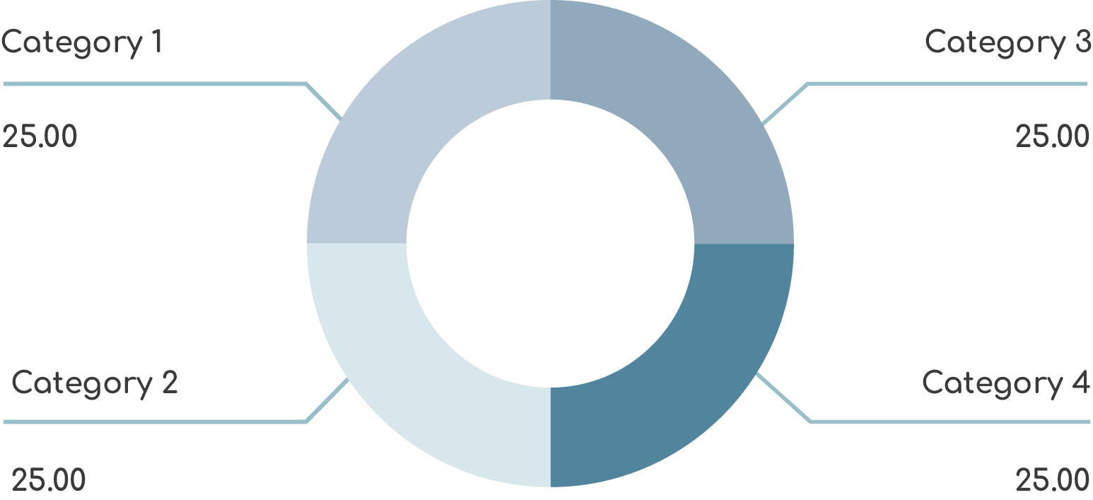
7.1.4 Revenue Forecast
Include a chart that shows your projected revenue.
Page 25

Slide 26
7.2 Financing
7.2.1 Sources of Funding
List all funding sources you are using or plan to use.
Mention whether the funds come from investors, loans, grants, personal savings, or revenue reinvestment.
Provide estimated amounts and terms (if applicable).
7.2.2 Use of Funding
Explain how the funds will be allocated to grow the business.
Show specific areas where the investment will be used.
Page 26

Slide 27
7.2.3 Future Funding Needs (if applicable)
If additional funding is expected in the future, mention when and how much will be needed.
Explain what milestones must be achieved before seeking more investment.
Page 27

Slide 28
7.3 Financial Statements
7.3.1 Profit & Loss
Add an income statement in the form of a spreadsheet that shows the company's revenues, expenses, and net profit (or loss) for a specific period (monthly, quarterly, or annually).
This spreadsheet will help investors understand your profitability and financial health.
Your
Profit & Loss
Report is Here
Page 28

Slide 29
7.3.2 Balance Sheet
Add a balance sheet, the state of your business at a specific point in time.
It includes assets, liabilities, and equity, showing how financially stable the business is.
Your
Balance Sheet
is Here
Page 29

Slide 30
8. Appendix
The Appendix is the final section of a business plan, containing supporting documents, charts, and additional information that back up the main sections
It helps investors and stakeholders verify the data and analysis provided throughout the plan.
Page 30

