Slide 1
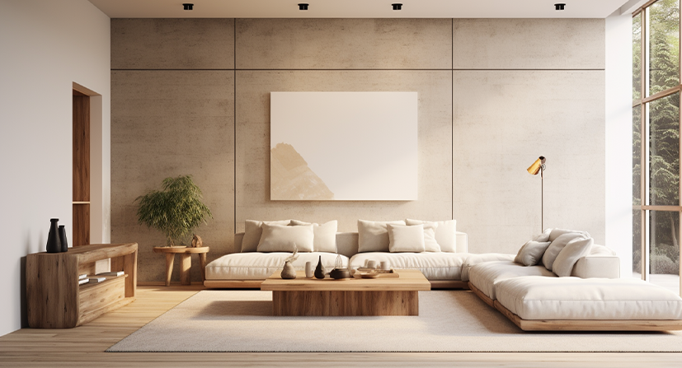
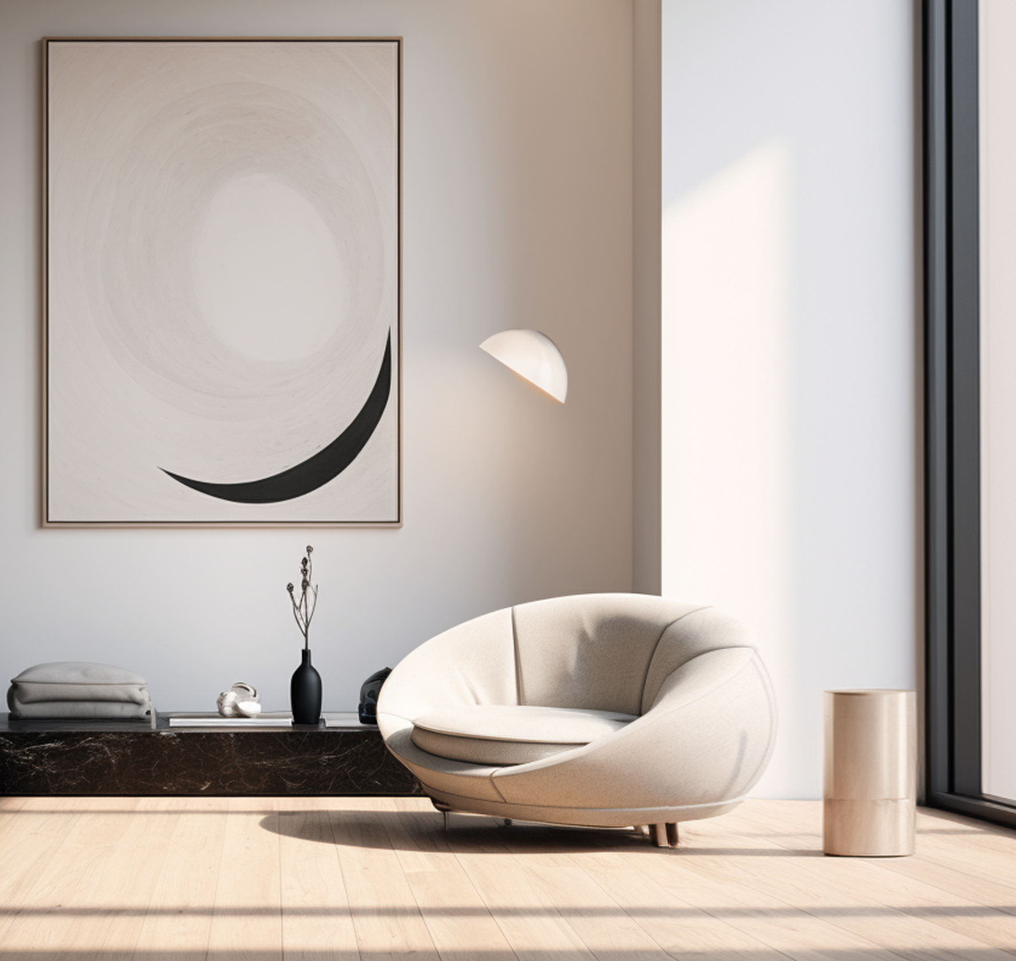
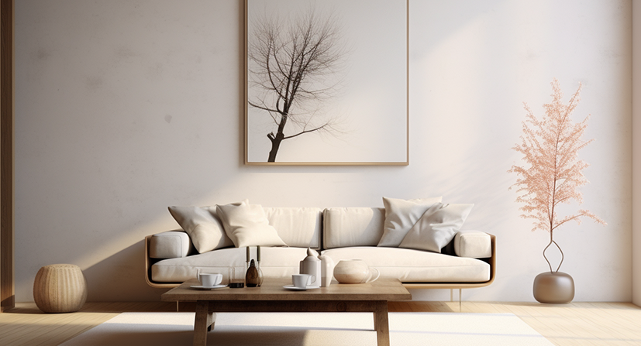
ABOUT US
GET IN TOUCH
ELEVATE YOUR SPACE
L E T ’ S S T A R T D E S I G N I N G Y O U R D R E A M S P A C E !
With a passion for innovation and aesthetics, we specialize in creating spaces that reflect your personality and lifestyle.
L E T ’ S S T A R T D E S I G N I N G Y O U R D R E A M S P A C E !
VISION:
To lead the industry by setting new standards in technology, sustainability, and customer satisfaction.
MISSION:
P H O N E : + 4 4 2 0 1 2 3 4 5 6 7 8
To empower businesses with cutting-edge industrial solutions that enhance efficiency and drive growth.
E M A I L : C O N T A C T @ E L E G A N T . L T D
W E B S I T E : E L E G A N T . L T D
A D D R E S S : 2 2 S T R E E T , L O N D O N , U K
S T Y L I S H . F U N C T I O N A L . T I M E L E S S

Slide 2
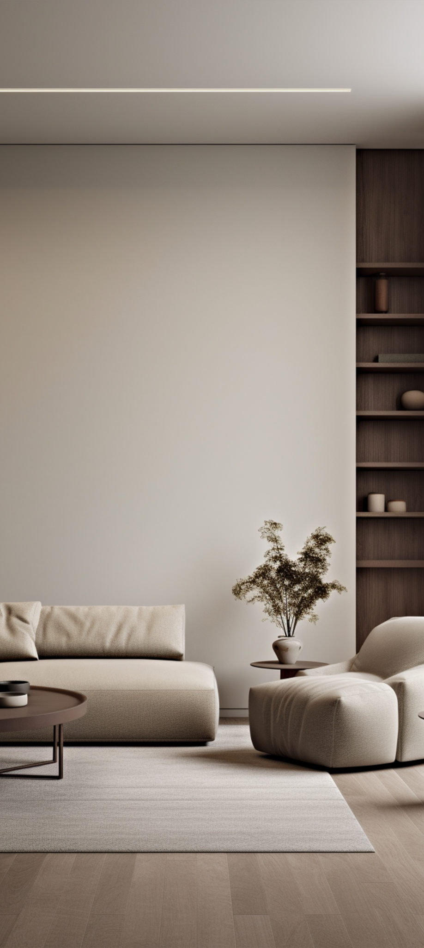
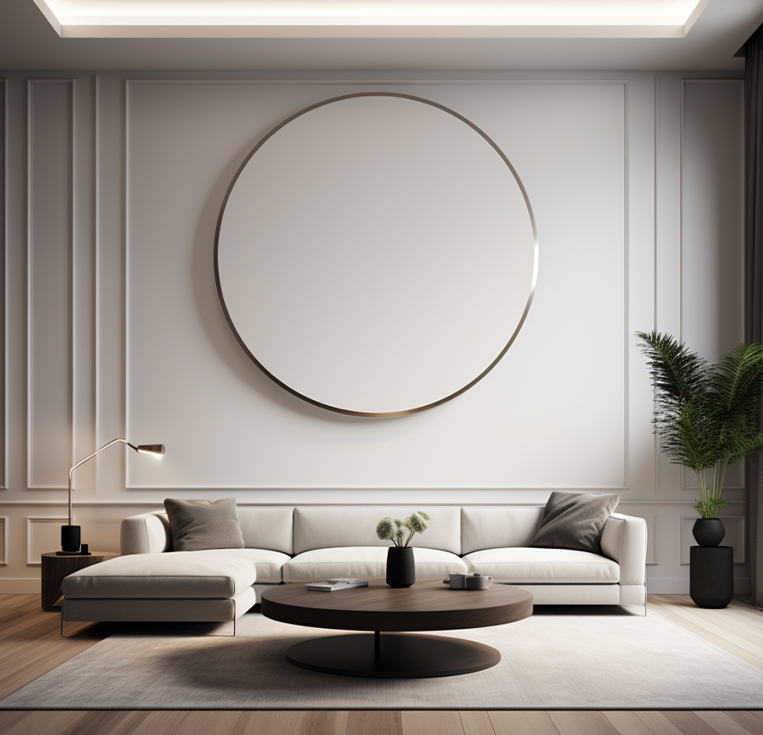
WHAT OUR CLIENTS SAY
OUR EXPERTISE
"Elegant Spaces Studio turned our
house into a modern masterpiece. We
couldn’t be happier!"
— Olivia Johnson, Homeowner
"The team at Elegant Spaces Studio
brought our dream office to life. It’s both
functional and beautiful!"
— Daniel Smith, CEO, BrightTech
Solutions
"Their attention to detail and design
expertise is unmatched. Highly
recommend for any interior project!"
E L E G A N T
S P A C E S S T U D I 0
L E T U S T R A N S F O R M Y O U R V I S I O N I N T O R E A L I T Y W I T H A S P A C E T H A T T R U L Y F E E L S L I K E H O M E
— Amelia White, Restaurant Owner
Residential Design:
Customized solutions for homes, apartments,
and villas.
OUR BENEFITS
Commercial Spaces:
Sleek and professional interiors for offices, restaurants, and retail stores.
Tailored Designs:
Every project is unique, just like you.
Space Planning:
Maximizing functionality without compromising on style.
Modern Aesthetics:
Combining contemporary trends with
timeless appeal.
Furniture & Décor Selection:
Handpicked pieces to bring your vision to life.
Experienced Team:
Our designers bring creativity and
professionalism to every project.
Our designs prioritize comfort, practicality, and timeless elegance.

