Slide 1
Company Name
04/17/2028
BUSINESS GROWTH PLAN
Prepared by:
Oliver Bennett

Slide 2
Table of Contents
1. EXECUTIVE SUMMARY
2. BUSINESS OVERVIEW
3. OBJECTIVES
3.1 Increase Revenue and Profitability
3.2 Expand Market Reach
3.3 Enhance Product/Service Offerings
3.4. Strengthen Brand Presence
3.5. Improve Operational Efficiency
3.6. Expand Human Resources
4. MARKET ANALYSIS
4.1 Industry Overview
4.2 Target Market
4.3. Competitive Analysis
4.4. Market Trends
5. GROWTH STRATEGIES
5.1 Market Penetration
5.2 Market Development
5.3. Product Development
5.4. Diversification
6. FINANCIAL PLAN
6.1 Revenue Projections
6.2. Budget Allocation
6.3. Funding Requirements
7. RISK MANAGEMENT
7.1 Risk Identification
7.2 Mitigation Strategies
7.3. Contingency Planning
8. IMPLEMENTATION TIMELINE
9. MONITORING AND EVALUATION
9.1 Performance Metrics
9.2 Review Frequency
9.3. Reporting
03
04
05
05
06
06
07
07
08
09
09
09
10
10
11
11
11
12
12
13
14
14
15
16
16
16
17
18
19
19
19
20
2

Slide 3
1. EXECUTIVE SUMMARY
This section summarizes the overall business growth strategy, highlighting key goals, expansion plans, and expected outcomes.
Example:
XYZ Tech plans to expand into two new markets within 18 months, increase customer acquisition by 40%, and double revenue by Q4 2026 through digital innovation and strategic partnerships.
3

Slide 4
2. BUSINESS OVERVIEW
Provide a summary of the company’s history, mission, current operations, and business structure
Example:
XYZ Tech was founded in 2020, offering cloud-based accounting tools to small businesses.
Company Name | [Your Company Name]
Owner/CEO | [Your Name]
Email | [Your Email]
Address | [Your Company Address]
Website | [Your Company Website]
4

Slide 5
3. OBJECTIVES
List specific, measurable growth goals.
Example:
- Expand to 3 new regions
- Launch 2 new product features
- Reach $5M in annual revenue by 2026
3.1 Increase Revenue and Profitability
Example:
- Expand to 3 new regions
- Launch 2 new product features
- Reach $5M in annual revenue by 2026
5

Slide 6
3.2 Expand Market Reach
Example:
- Expand into three additional regions and grow market presence by reaching new customer segments, including young professionals and small businesses.
3.3. Enhance Product/Service Offerings
Example:
- Introduce two new products tailored to evolving customer demands and refine existing offerings in response to feedback and market insights.
6

Slide 7
3.4. Strengthen Brand Presence
Example:
- Increase brand visibility through integrated marketing efforts, active social media presence, and strategic public relations.
- Improve customer loyalty and engagement through enhanced support and dedicated retention programs.
3.5. Improve Operational Efficiency
Example:
- Optimize internal processes to achieve a 15% cost reduction and enhance productivity through the adoption of technologies such as CRM systems and automation tools.
7

Slide 8
3.6. Expand Human Resources
Example:
- Hire 10 qualified professionals to support business expansion and invest in employee training to boost current team performance and capabilities.
8

Slide 9
4. MARKET ANALYSIS
4.1 Industry Overview
Example:
- The retail sector continues to grow steadily, fueled by rising consumer expenditure and the expanding influence of e-commerce.
4.2 Target Market
Example:
- The target audience includes urban-based young professionals (ages 25–35) and small businesses seeking cost-effective, high-quality products.
9

Slide 10
4.3. Competitive Analysis
Example:
- Major competitors—Competitor A, Competitor B, and Competitor C—maintain robust online platforms and offer a wide range of products.
4.4. Market Trends
Example:
- Key market trends include increased online purchasing, a focus on personalized customer interactions, and rising interest in eco-friendly products.
10

Slide 11
5. GROWTH STRATEGIES
5.1 Market Penetration
Example:
- Boost sales within current markets by leveraging promotions, special offers, and loyalty programs to retain and attract customers.
5.2 Market Development
Example:
- Pursue growth by entering untapped markets through regional analysis, strategic research, and the creation of new distribution pathways.
11

Slide 12
5.3. Product Development
Example:
- Develop new offerings by investing in research and development, leveraging customer insights, and staying aligned with industry trends.
5.4. Diversification
Example:
- Pursue growth by exploring adjacent industries, building strategic partnerships, and introducing complementary products or services.
12

Slide 13
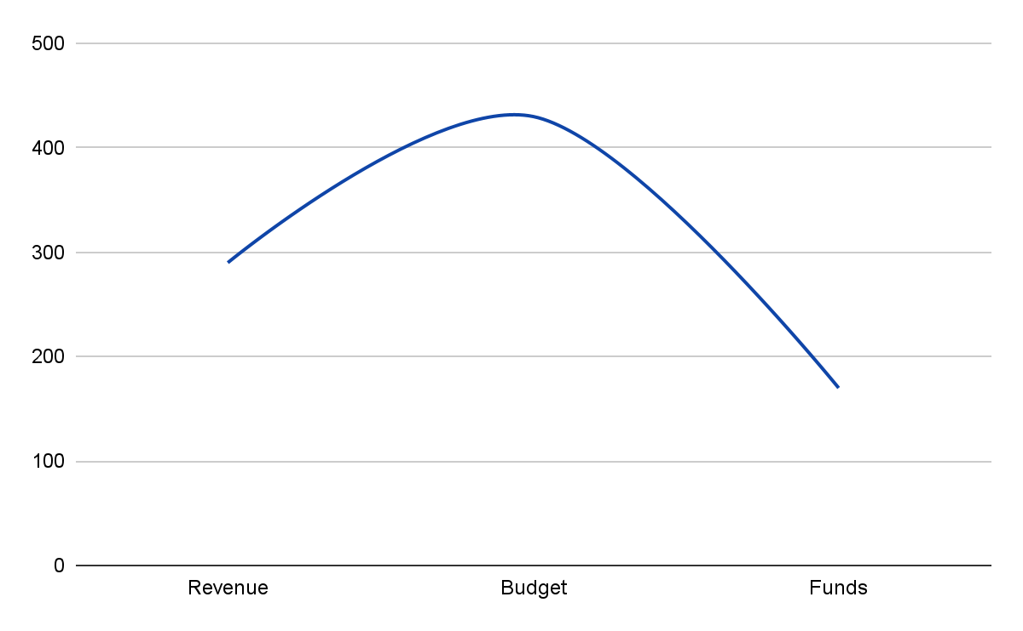
6. FINANCIAL PLAN
Insert a multi-year financial projection chart (bar or line graph) showing annual revenue, expenses, and profit to visualize expected growth and financial stability.
13

Slide 14
6.1 Revenue Projections
Example:
- Projected revenue is expected to grow from $1.5 million in Year 1 to $1.8 million in Year 2, reaching $2.2 million by Year 3.
6.3. Funding Requirements
Example:
- The business seeks $500,000 in funding to support market expansion, develop new products, and implement advanced technologies. Potential funding sources include bank loans, private investors, and government grant programs.
14

Slide 15
6.3. Funding Requirements
Example:
- The business seeks $500,000 in funding to support market expansion, develop new products, and implement advanced technologies. Potential funding sources include bank loans, private investors, and government grant programs.
15

Slide 16
7. RISK MANAGEMENT
7.1 Risk Identification
Example:
- Key risks include market oversaturation, economic instability, and potential disruptions in the supply chain.
7.2 Mitigation Strategies
Example:
- To reduce risk exposure, the company will diversify its supplier base, implement a flexible budgeting approach, and perform ongoing market assessments.
16

Slide 17
7.3. Contingency Planning
Example:
- Contingency measures include maintaining emergency reserves, preparing alternative marketing approaches, and forming a dedicated crisis response team.
17

Slide 18
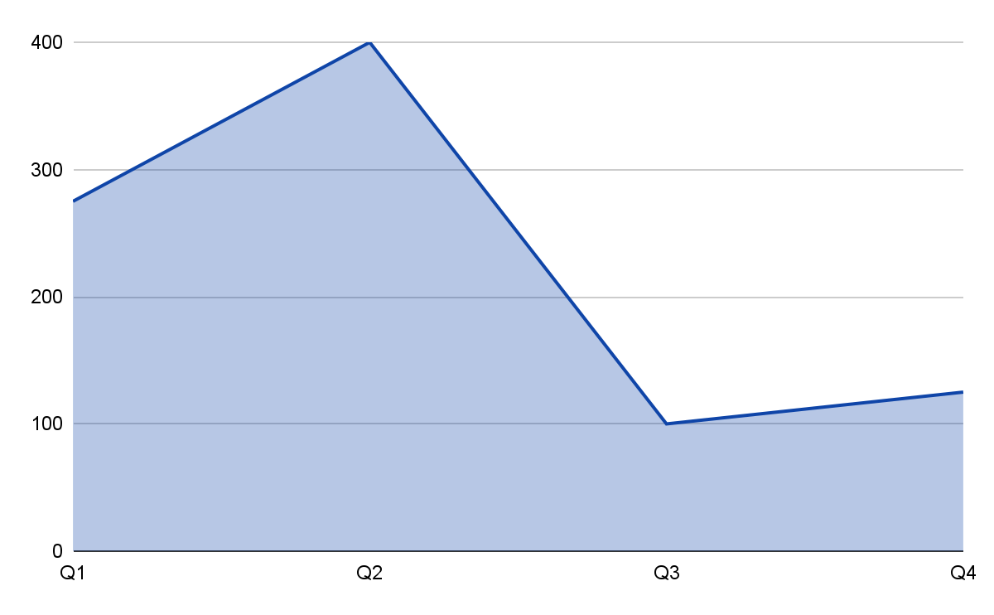
8. IMPLEMENTATION TIMELINE
Insert a quarterly line chart illustrating the distribution of key activities or investments throughout the year. The Y-axis represents effort, cost, or volume of initiatives, while the X-axis shows quarters (Q1 to Q4). This visualization helps highlight the intensity of execution at each phase of the growth plan.
18

Slide 19
9. MONITORING AND EVALUATION
9.1 Performance Metrics
Example:
- Key performance indicators (KPIs) will include monthly revenue, customer acquisition, profit margins, and staff productivity to monitor business progress.
9.2 Review Frequency
Example:
- Monthly reviews to assess short-term goals, quarterly reviews for strategic adjustments, and annual reviews for long-term planning.
19

Slide 20
9.3. Reporting
Example:
- Progress will be reported to stakeholders and management teams through detailed reports and presentations.
20

