Slide 1
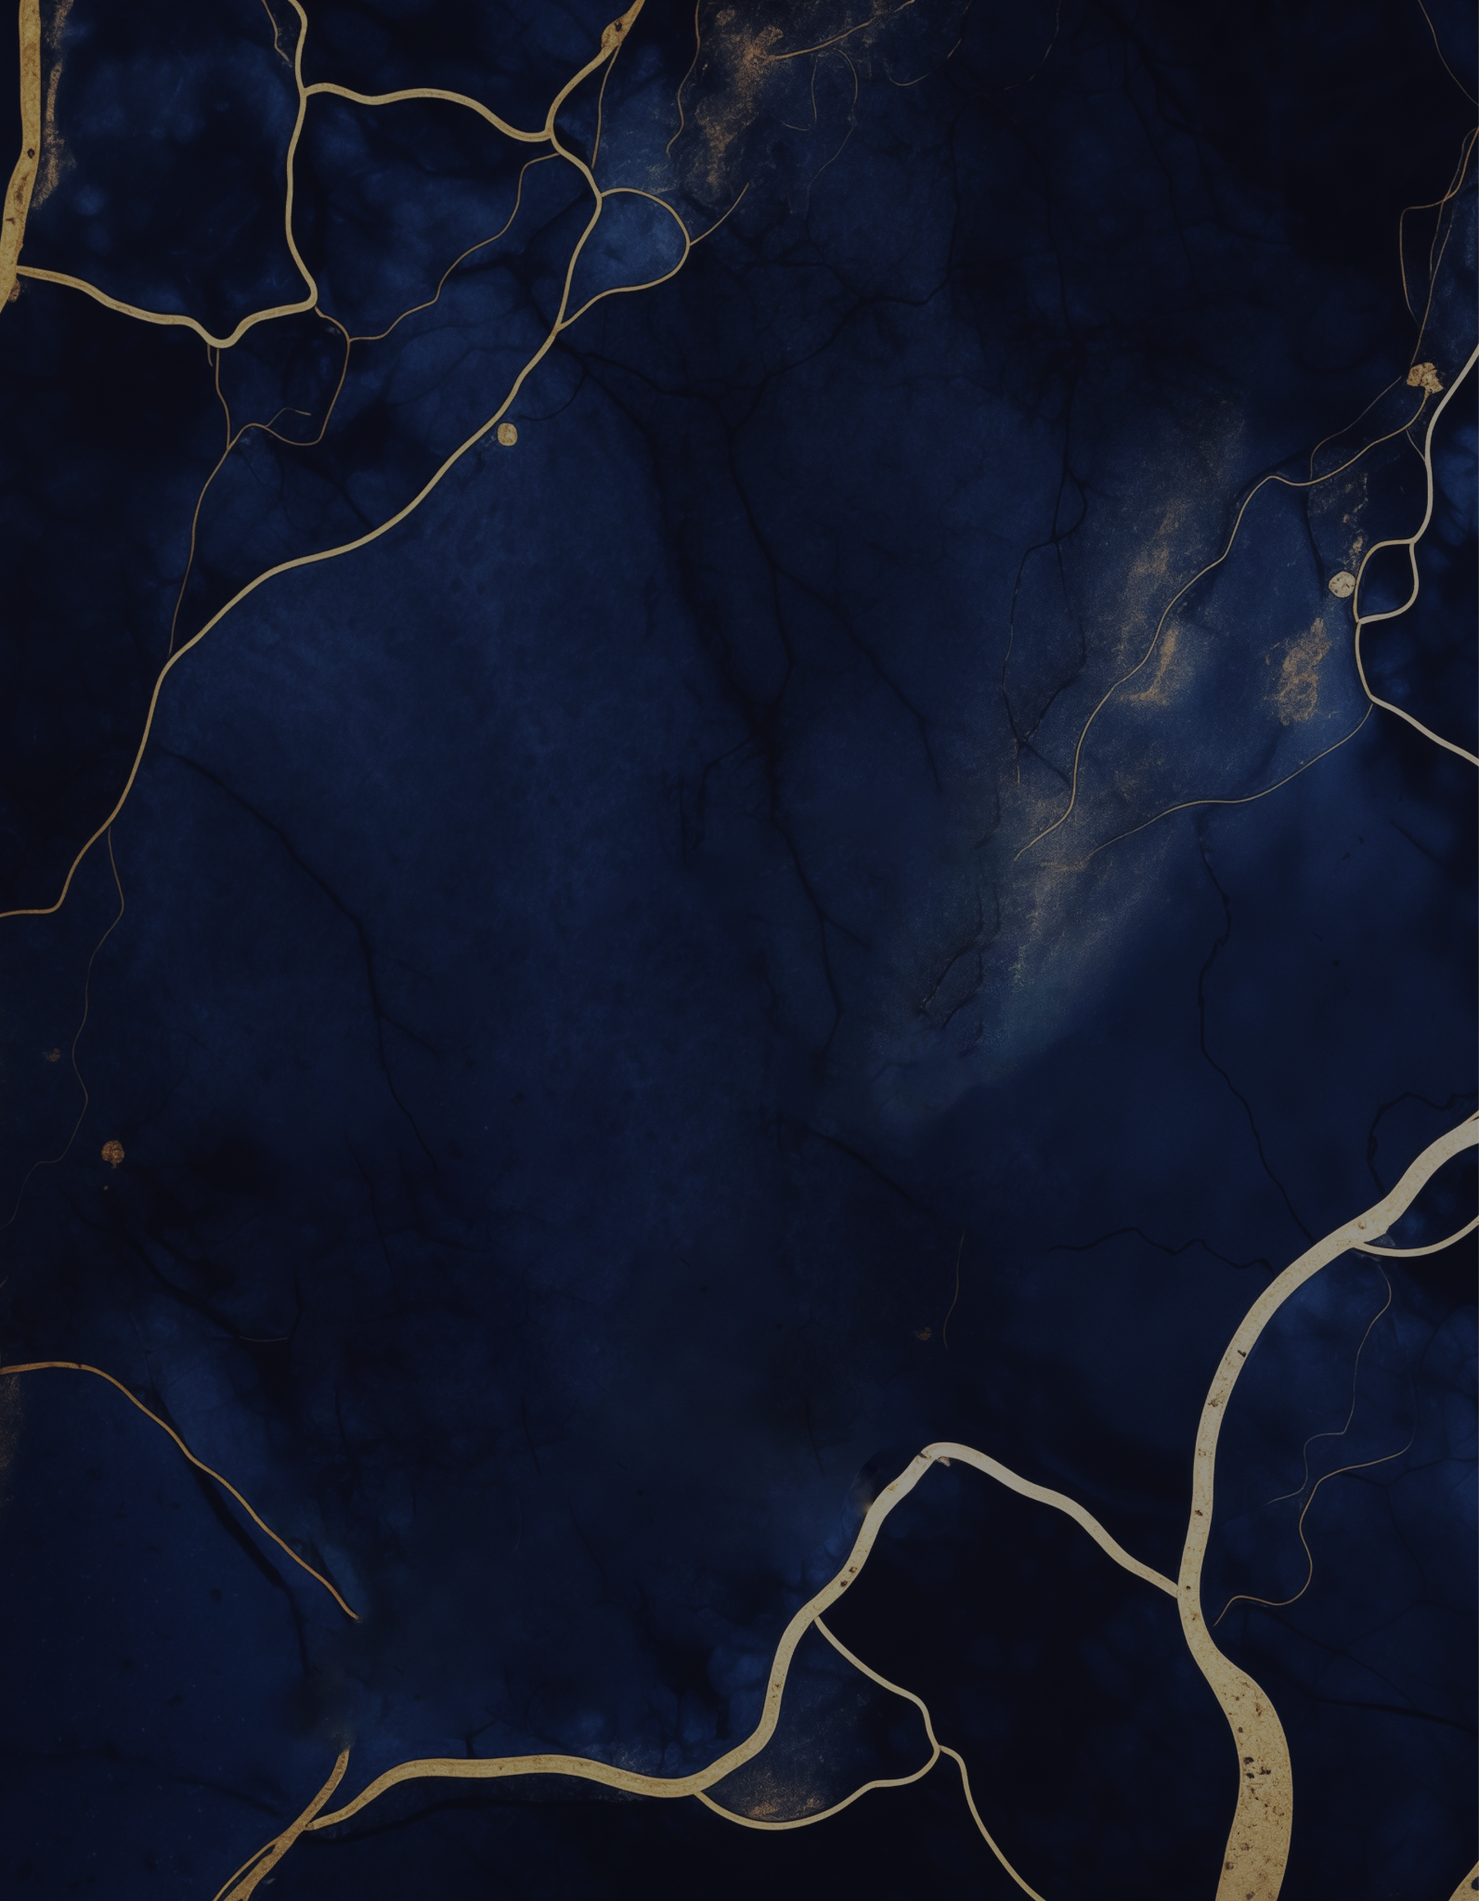
LOGO
We are delighted to invite you to our
Global Business
Forum
M O N D A Y
4 : 3 0 P M
JUNE 12, 2026
Join us for an inspiring and insightful event where professionals from around the world come together to share knowledge and network!
GRAND HALL
The Liberty Center, 345 Freedom Avenue
Boston, Massachusetts

