Slide 1

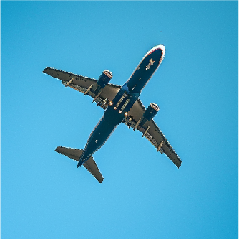




TRAVEL ITINERARY
FOUR DAYS - LONG TRIP
Departure: May 14, 2025 | 11:00 AM
Arrival: May 18, 2025 | 11:00 AM
TIME:
ACTIVITY:
NOTES:
08:00 AM
Flight to [Destination]
10:00 AM
Arrive at [Destination]
Collect luggage, transportation
11:00 AM
Check-in at Hotel
Rest and unpack
DAY
01
02:00 PM
Explore Local Area
Casual walking tour
05:00 PM
Return to Hotel
Relax and unwind
TIME:
ACTIVITY:
NOTES:
08:00 AM
Breakfast
09:00 AM
Guided City Tour
Meet at lobby
12:00 PM
Lunch
DAY
02
01:00 PM
Visit [Attraction]
Entry at 1:30 PM
04:00 PM
Free Time
Explore local shops
TIME:
ACTIVITY:
NOTES:
08:00 AM
Breakfast
09:00 AM
Day Trip to [Location]
Bus departs at 9:00 AM
12:00 PM
Lunch
During day trip
DAY
03
02:00 PM
Activity at [Destination]
Tickets booked
05:00 PM
Return to Hotel
Rest
TIME:
ACTIVITY:
NOTES:
08:00 AM
Breakfast
11:00 AM
Departure from the hotel
Check-out process
1:00 PM
Departure for Airport
Transport arranged
DAY
04
3:00 PM
Flight Home
5:00 PM
Arrive Home

