Slide 1
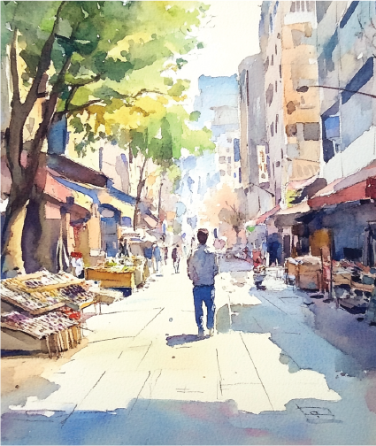

Slide 2
PLACE FOR YOUR
PHOTO OR PICTURE

