Slide 1
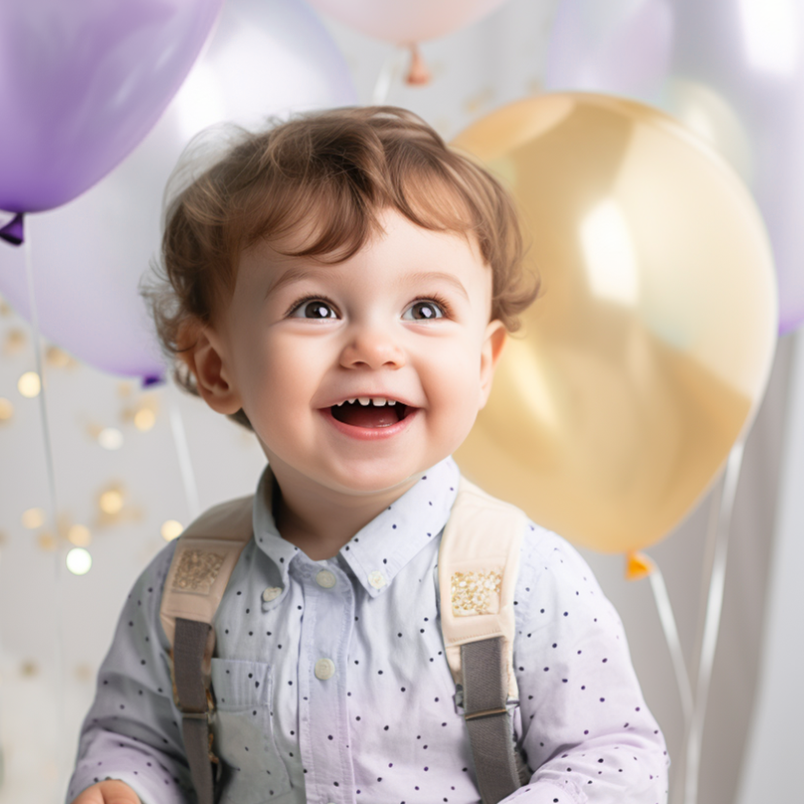











Join us to celebrate
ETHAN'S
3RD BIRTHDAY!
July 10th, 2024
|
2:00 PM - 5:00 PM
Location: 123 Happy Lane, Funville
Please RSVP by July 5th to Ethan's Mom at
(555) 123-4567

