Slide 1

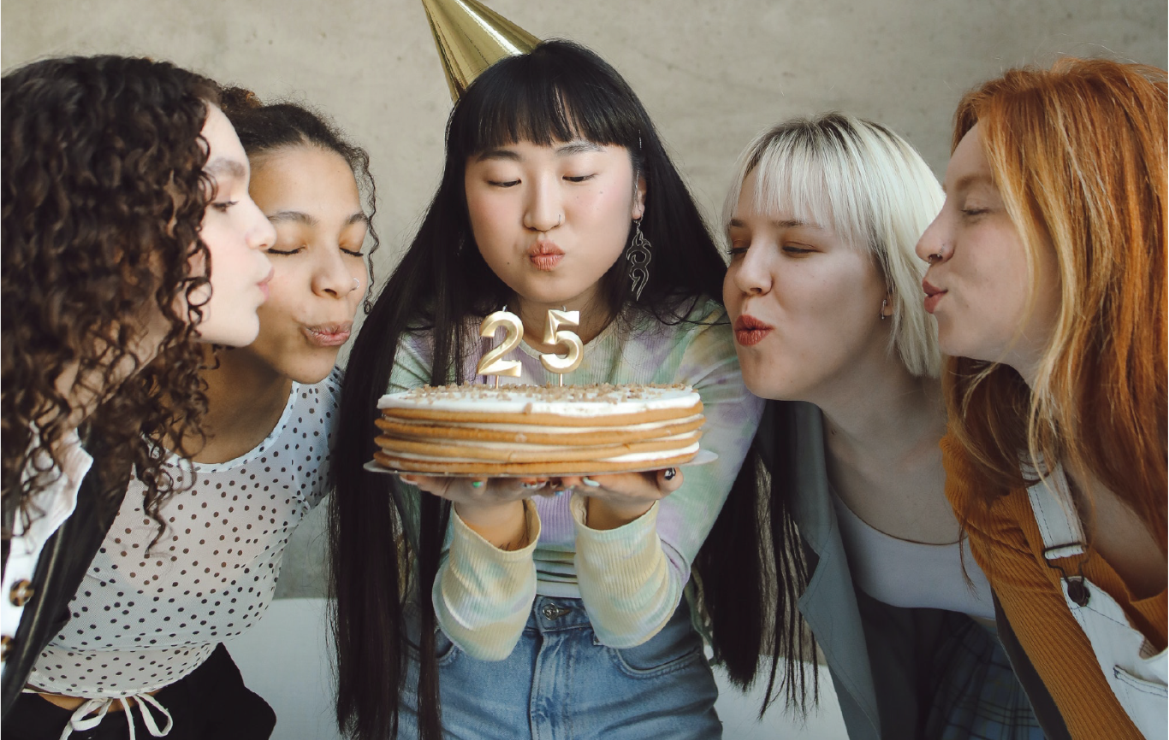

SHEILA ‘ S
BIRTHDAY
Celebration
SATURDAY, FEBRUARY 8TH
Aliquam convallis ante quis bibendum elementum. Integer placerat lectus non elit vehicula sodales.
123 ANYWHERE, ST., ANY CITY, ST 12345
COME CELEBRATE WITH US

