Slide 1
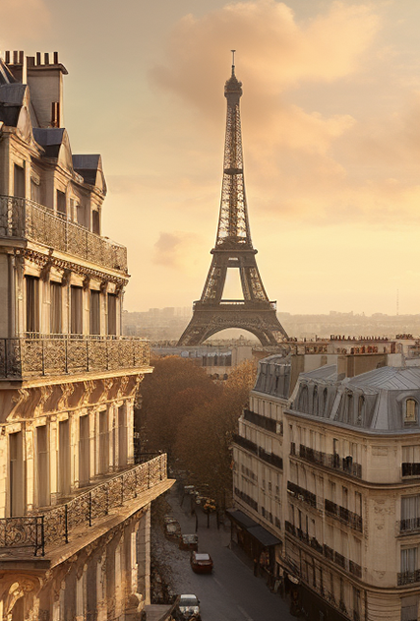
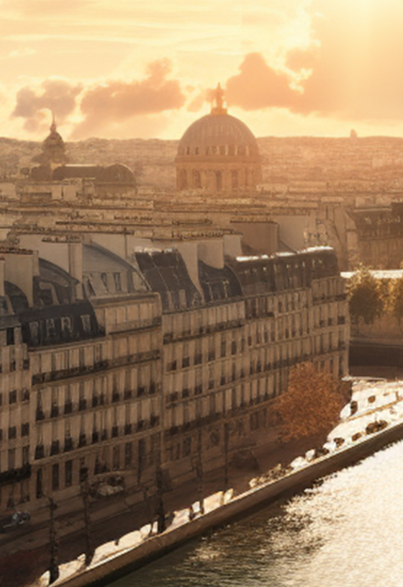
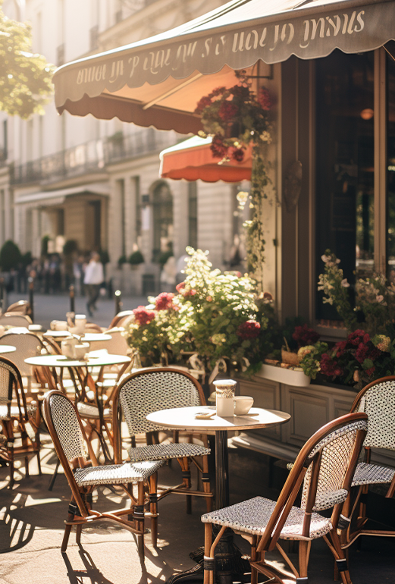
Paris
TRAVEL ITINERARY
Destination: Paris, France
Duration: 3 Days
Date: April 15–17, 2025
Departure: 8:00 AM
Day 1 – Eiffel Tower & Seine River
Morning (09:00–12:00) - Begin your day with a visit to the iconic Eiffel Tower. Enjoy panoramic views of the city from the observation deck.
Afternoon (14:00–17:00) - Relax on a Seine River cruise. Marvel at historic landmarks like Notre-Dame and the Louvre from the water.
Day 2 – Montmartre & Louvre Museum
Morning (09:00–12:00) - Stroll through the charming streets of Montmartre and visit the Sacré-Cœur Basilica for breathtaking city views.
Afternoon (14:00–17:00) - Explore the world-famous Louvre Museum
and discover masterpieces like the Mona Lisa and Venus de Milo.
Day 3 – Versailles Palace
Morning (09:00–12:00) - Take a guided tour of the opulent Palace of Versailles, including the Hall of Mirrors and the royal gardens.
Afternoon (14:00–17:00) - Return to Paris for some free time to shop at Champs-Élysées or enjoy local cuisine at a nearby café.

