Slide 1
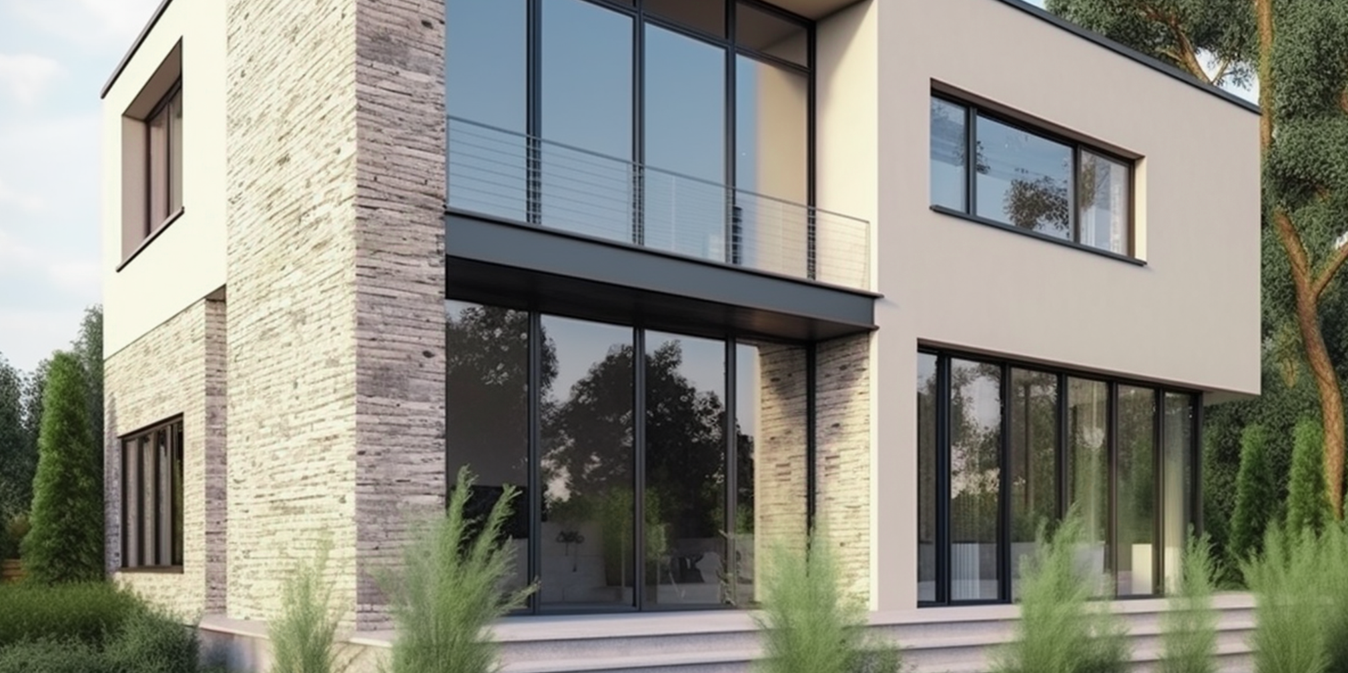
GREETINGS,
DEAR CLIENTS!
Summer is a time for new beginnings and incredible opportunities. If you're in search of your perfect living space, we have some exciting offerings for you.
LifeHouse Realtors
Where Your Dream
Creates Life
Y O U R I D E A L H O M E A W A I T S Y O U !
H A R M O N Y H O M E S R E A L T Y
E X C L U S I V E L I S T I N G S
P R I M E L O C A T I O N S
E X P E R T A P P R O A C H
Our team is working tirelessly to find the best real estate options for you. Gain access to exclusive listings that impress with their beauty and functionality.
We only select places that ensure comfort and safety. Explore properties in the most popular and convenient
city locations.
Our experts are ready to provide you with all the necessary information and consultations regarding each property. We care about your comfort.
PHONE: +1 (555) 123-4567
123 HARMONY STREET,
EMAIL: INFO@HARMONY.COM
CITYVILLE, DREAMLAND
Mark your calendar for our upcoming Open House events. It's a fantastic opportunity to explore multiple properties in one day and get a feel for the diverse real estate options available. Don't let this summer pass by without finding the home you've always dreamed of. Contact us today
at to schedule viewings, discuss financing options, or simply chat about your real estate goals.
HERE YOU WILL FIND YOUR DREAM HOME AND MAKE THIS SUMMER UNFORGETTABLE!

