Slide 1
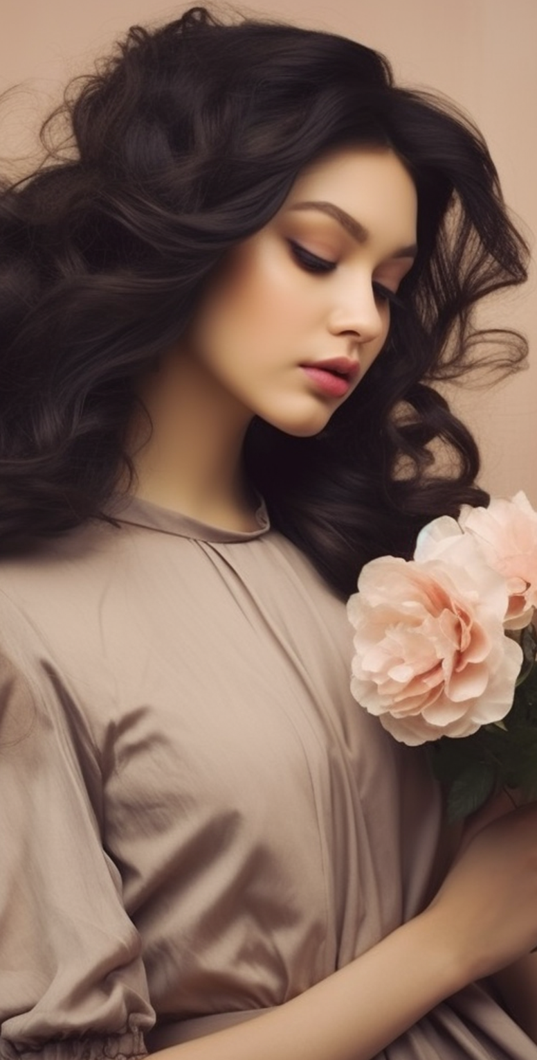
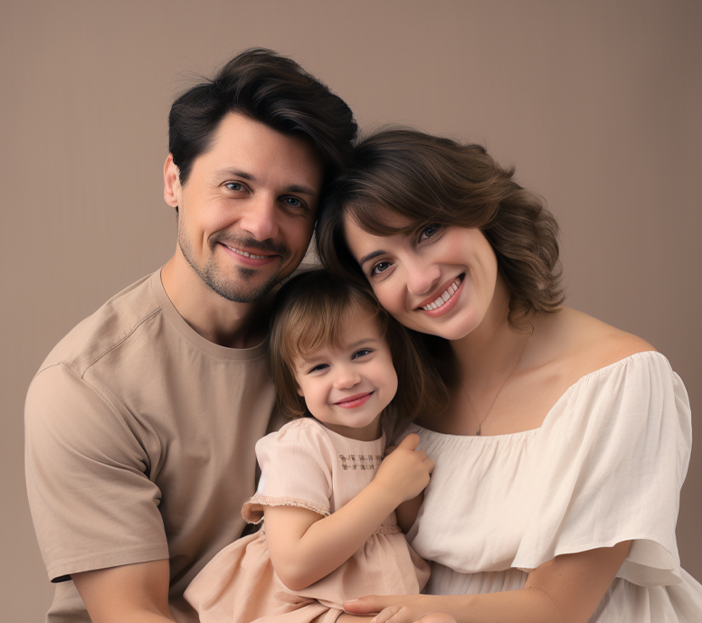
PRICE LIST
A U R O R A C A P T U R E S
THEMES:
DURATION:
PRICE:
PORTRAIT SESSION
1 HOUR
$150
Capture your unique personality in a relaxed and comfortable environment. Our one
hour portrait session allows for up to three different poses, ensuring you get a variety of shots to choose from.
FAMILY PHOTO SESSION
1.5 HOURS
$250
Preserve beautiful family moments with our 1.5-hour family photo session. We'll capture your family's essence through up to five different poses, resulting in 20 high-resolution digital images.
ENGAGEMENT SESSION
2 HOURS
$350
Celebrate your love story with a 2-hour engagement session. We'll work with you to create up to seven unique poses that showcase your connection and personalities. Save-the-dates, or to simply cherish this special time in your lives.
GRADUATION SESSION
2 HOURS
$375
Commemorate your academic achievements with a 2-hour graduation session. We'll create up to seven different poses that highlight your success. You'll receive 30 high-resolution digital images.
EVENT PHOTOGRAPHY
VARIABLE
$300
Our event photography services are perfect for birthdays, anniversaries, and small gatherings. The duration of coverage can vary based on your event's needs. We'll capture the key moments, candid shots, and group photos.
ADDITIONAL SERVICES:
PRINTS:
We offer a variety of print sizes and materials, from standard prints to canvas and metal prints. Contact us for pricing and options to decorate your home with your favorite.
PHOTO ALBUMS:
Create a lasting keepsake with a professionally designed and printed photo album. We'll work with you to curate the best images from your session to tell your unique story.
EXTRA HOUR:
If you wish to extend your session beyond the allocated time, additional hours are available for $75 per hour.

