Slide 1
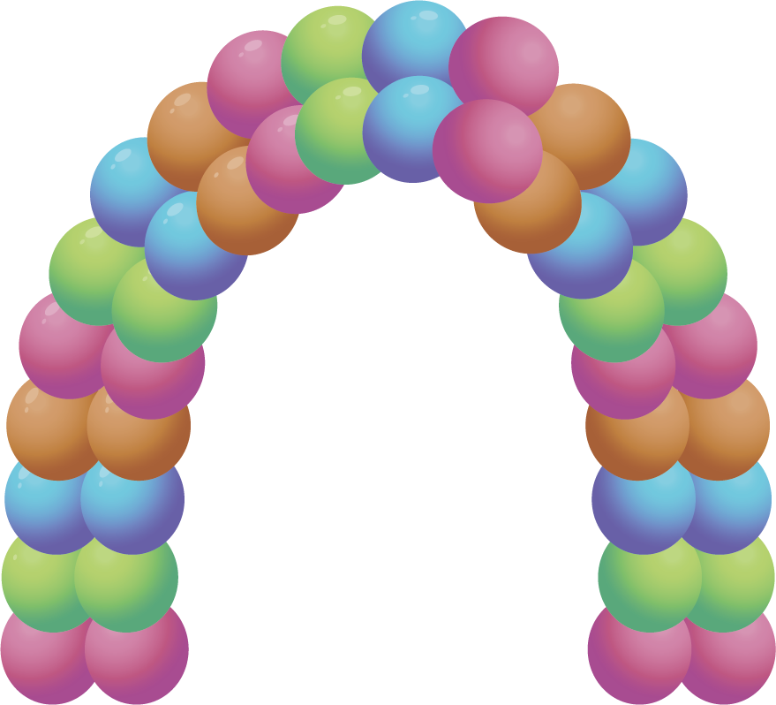
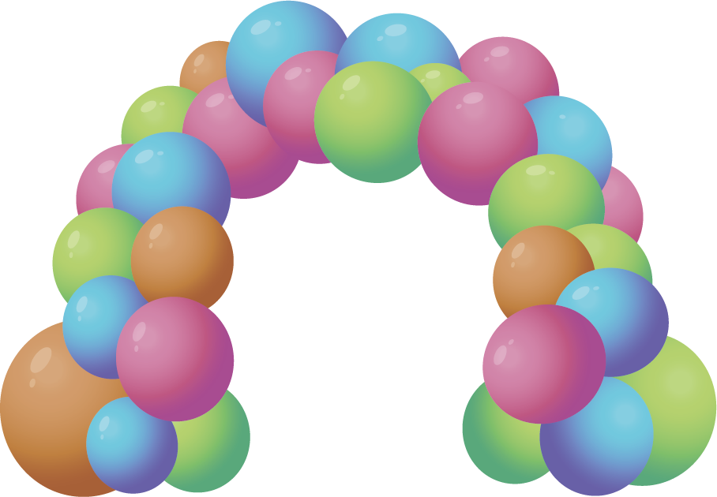
Balloon
@balloonsPriceList
+1 012-3456-789
@balloonsPriceList
Price List
balloonsPriceList.com
Garland-To-Go
$25.00
Balloon Wall
Starting of $65.00
Traditional Arch
$235.00
Organic Style Arch
$250.00
Basic Organic Garland
Starting of $75.00
Classic Organic Garland
Starting of $95.00
Deluxe Organic Garland
Starting of $115.00

Slide 2
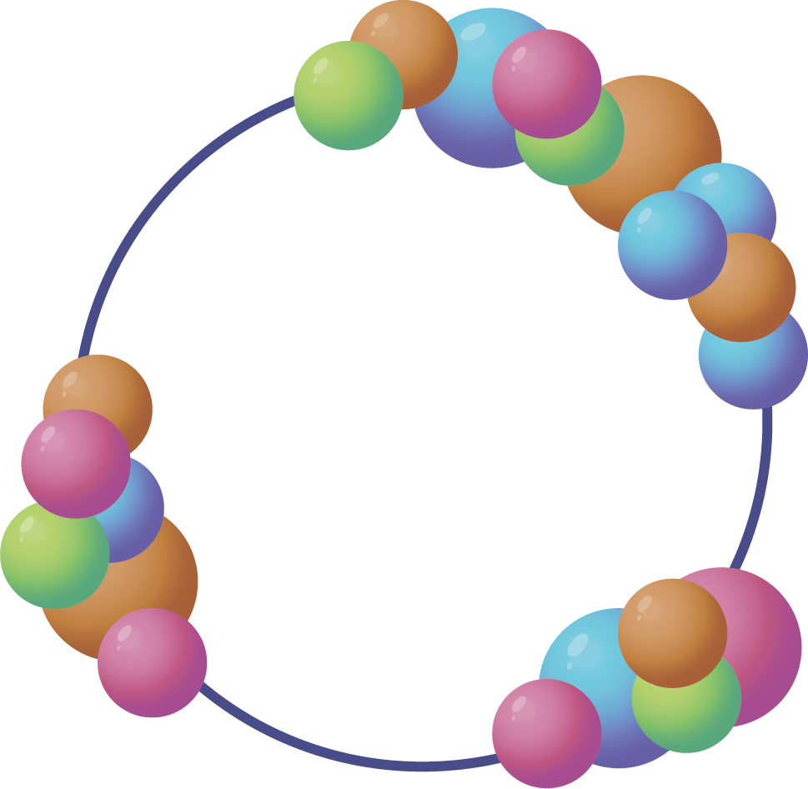
Balloon
@balloonsPriceList
+1 012-3456-789
@balloonsPriceList
Price List
balloonsPriceList.com
Round Frame, Organic Garland
Starting of $65.00
Round Frame, Organic Full Garland
Starting of $95.00
Striped Column
$110.00
Spiral Column
$115.00
Roman Column
$120.00
Classic Bouquet
$75.00

