Slide 1
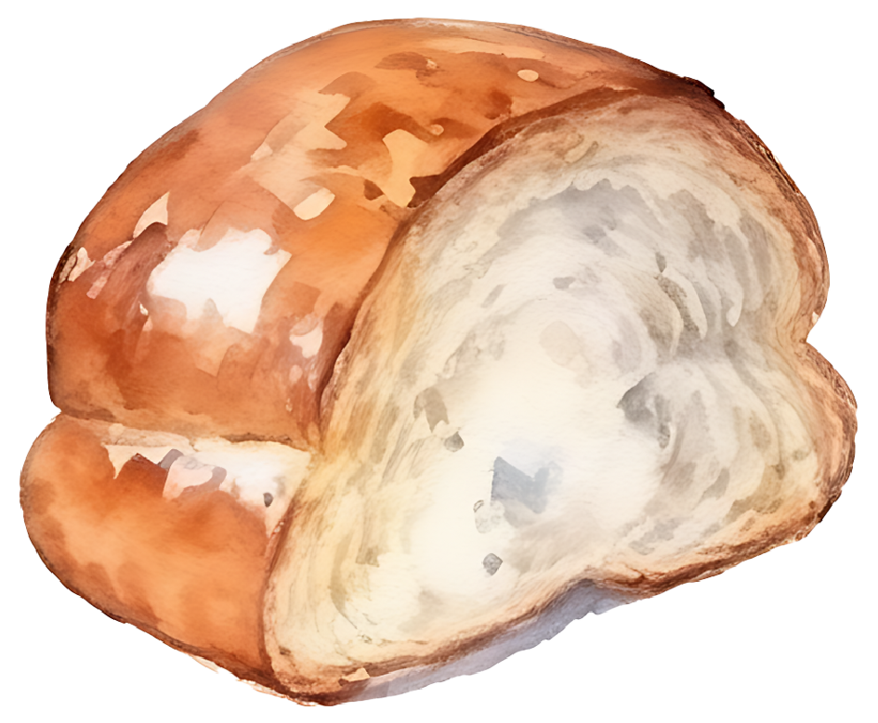
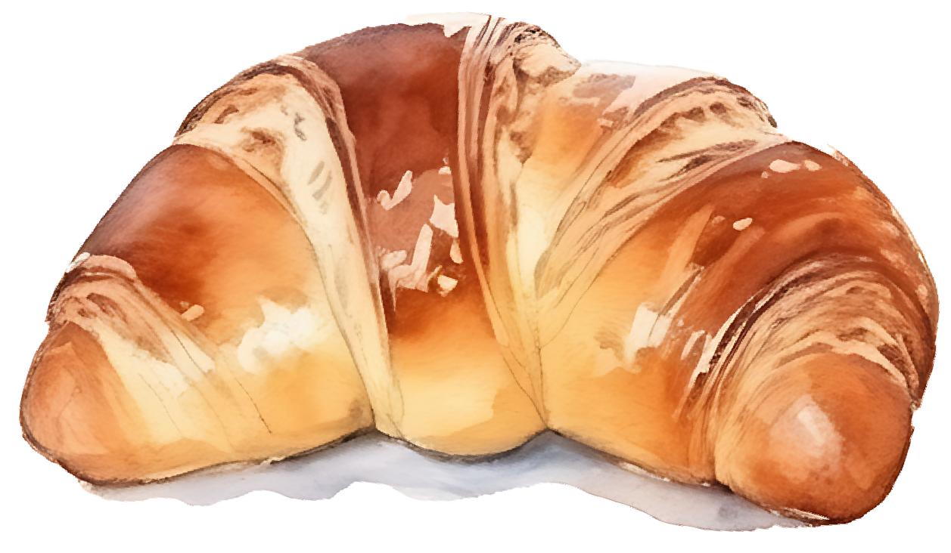
BAKERY
Price List

Slide 2
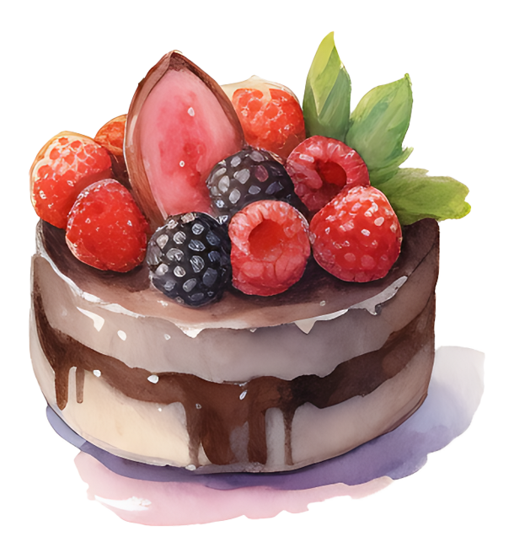
BAKERY
Price List
CAKES:
Chocolate Cake
$3.50 per slice
Vanilla Cake
$3.00 per slice
Carrot Cake
$3.25 per slice
Banana Cake
$3.75 per slice
COOKIES:
Chocolate Chip Cookies
$4.00 for a pack of 6
Oatmeal Cookies
$3.50 for a pack of 6
Ginger Cookies
$4.50 for a pack of 6
PIES:
Apple Pie
$20.00
Blueberry Pie
$25.00
Pumpkin Pie
$22.00
CREAM PUFFS:
Classic Cream Puffs
$1.50 each
Fruit Cream Puffs
$1.75 each
Chocolate Cream Puffs
$1.90 each
MUFFINS:
Chocolate Muffin
$2.50 each
Vanilla Muffin
$2.25 each
Berry Muffin
$2.75 each

