Slide 1
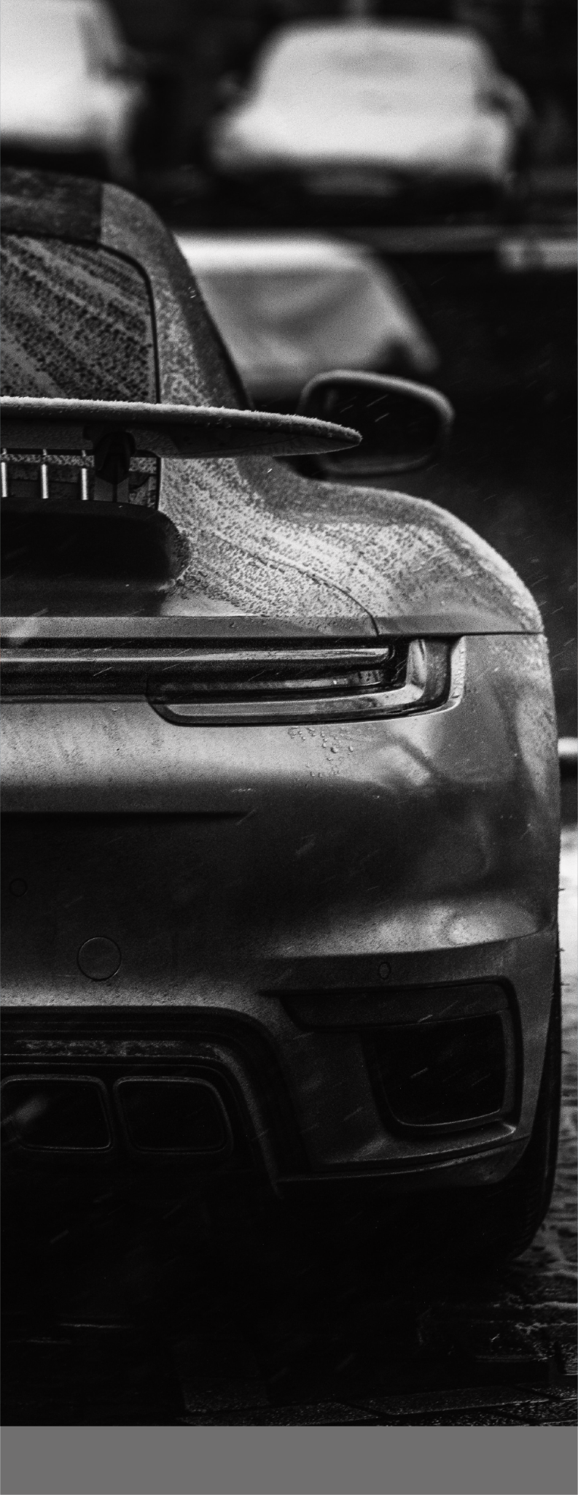
CAR
DETAILING
PRICE LIST
SMALL SUV
21 POINT WASH
$125 - $140
LEASE RETURN
$175 - $225
INTERIOR DETAIL
$175
EXTERIOR DETAIL
(WITH CERAMIC SEALANT & CLAYBAR TREATMENT)
$225
FULL DETAIL
$375
SUV
21 POINT WASH
$125 - $140
LEASE RETURN
$175 - $225
INTERIOR DETAIL
$175
EXTERIOR DETAIL
(WITH CERAMIC SEALANT & CLAYBAR TREATMENT)
$225
FULL DETAIL
$375
+00123456789
GDOC.IO

