Slide 1
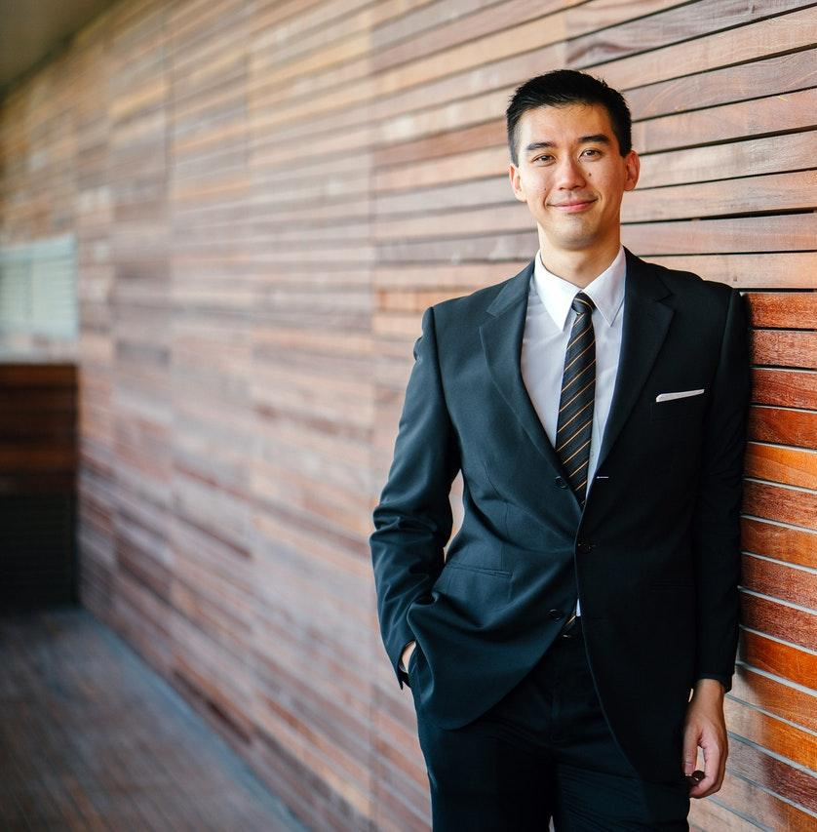
GRANT
BREITENBERG
lawyer & attorney

Slide 2
GRANT BREITENBERG
lawyer & attorney
Mobile: 012-345-6789
Website: example.com
Email: example@mail.com
Address: 5703 Rippin Crescent Apt, Bilzen 57073-7014

