Slide 1
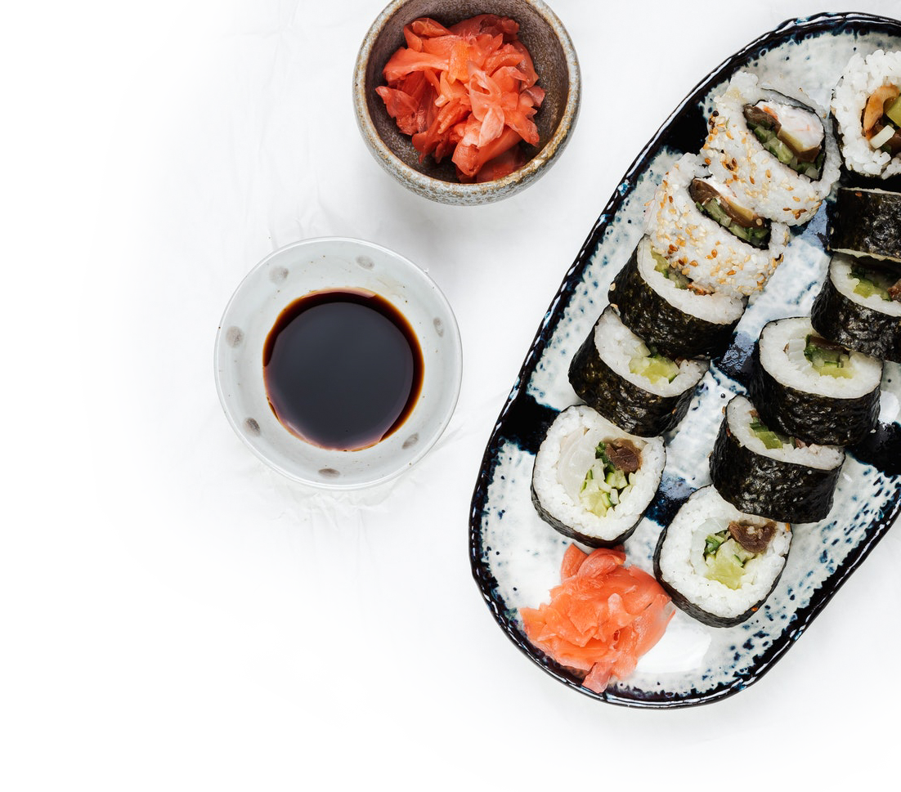
Japanese Food
Restaurant

Slide 2
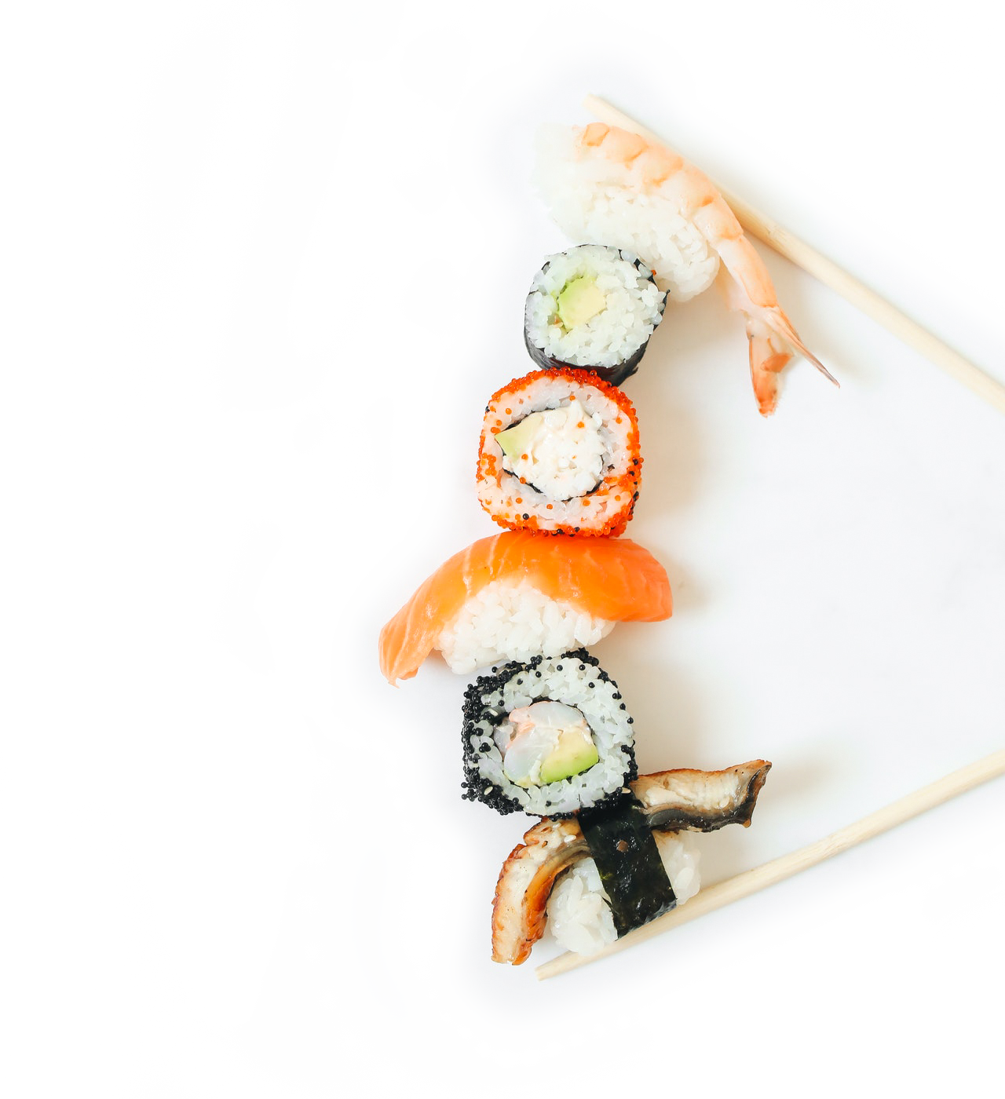
Japanese Food
Restaurant
123-456-7890
example@mail.com
www.example.com
86735 Floyd River, Rempelhaven
Bilzen, 12852

