Slide 1
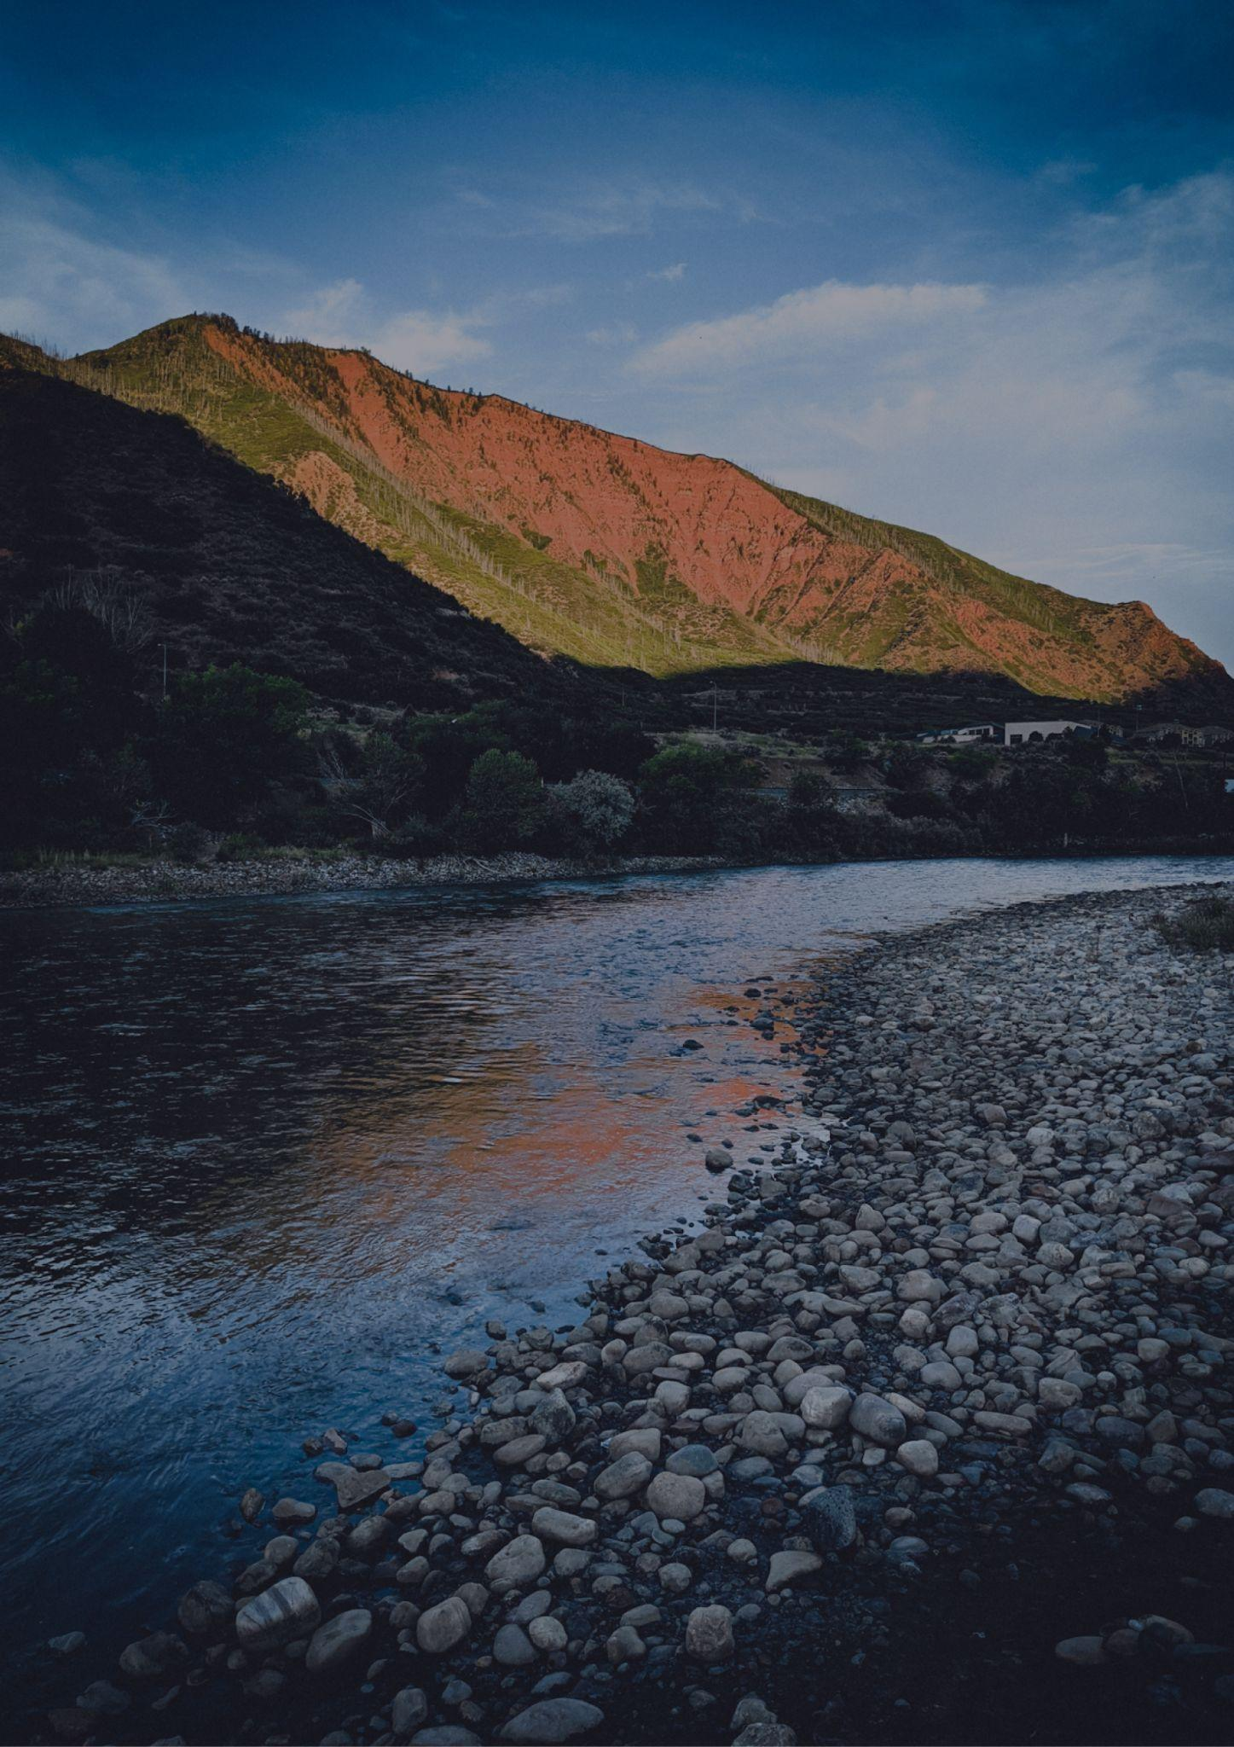
ARKANSAS
TRAVEL BUCKET LIST
Hot Springs National Park
Buffalo National River
Little Rock
Arkansas Air Museum
Clinton Presidential Library
Arkansas vacations: Hope
Crater of Diamonds State Park
Arkansas vacations: Hope
Thorncrown Chapel
Lake Ouachita
Mount Magazine State Park
Petit Jean State Park
Crystal Bridges Museum
Beaver Lake
Garvan Woodland Gardens
Grand Promenade
Blanchard Springs Caverns
Big Dam Bridge
The Walmart Museum
Mountain Trail
Bentonville
Ozark Folk Center State Park
Conway
Mount Magazine State Park
Fort Smith
Riverfront Park
Mountain Home
Lake Catherine State Park

