Slide 1
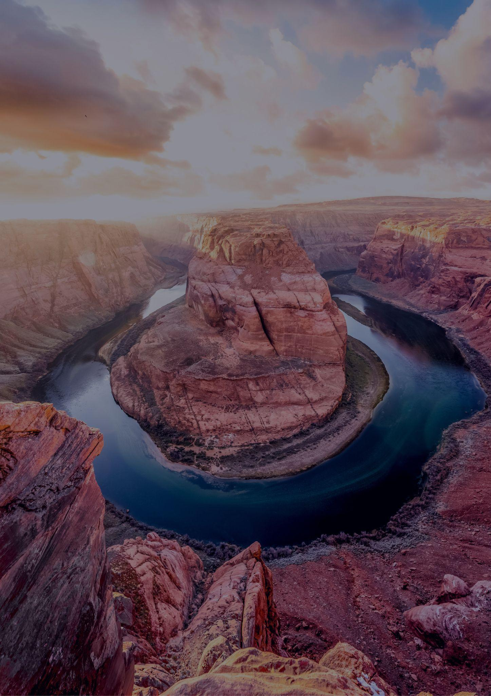
ARIZONA
TRAVEL BUCKET LIST
Grand Canyon
Monument Valley
Sedona
Phoenix
Hoover Dam
Jerome
Oatman
Canyon De Chelly
Horseshoe Bend
Havasu Falls
Bisbee
Lake Mead
Tombstone
Petrified Forest Park
Flagstaff
Saguaro National Park
Antelope Canyon at Page
Lake Havasu
Organ Pipe Cactus
Prescott
Yuma
Scottsdale
Tumacacori Park
Lake Powell & Page
Montezuma Castle
Sunset Crater Volcano
Lower Salt River
Apache Trail

