Slide 1

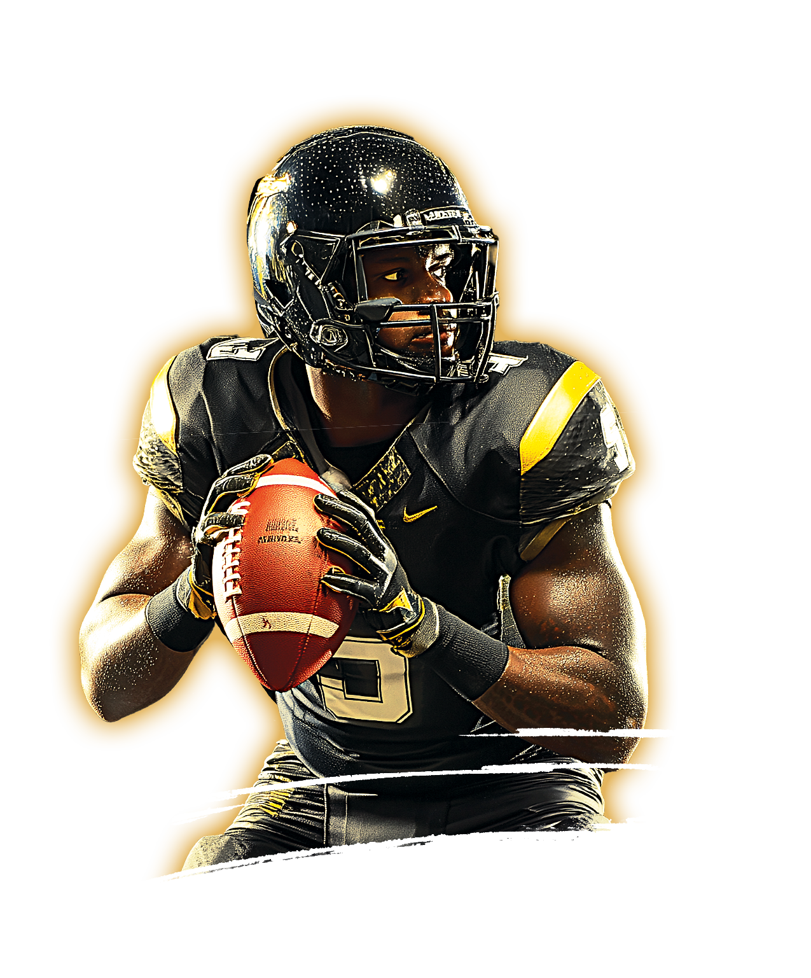

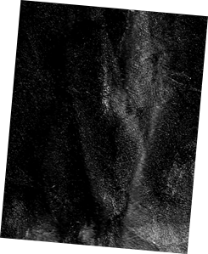




SAT
30
MARCH
GAMEDAY AT YOUR BAR
Las Vegas RIDERS
VS
new york giants
123.456.7890 i 123 east side i your pub name i miami, fl 12345

