Slide 1
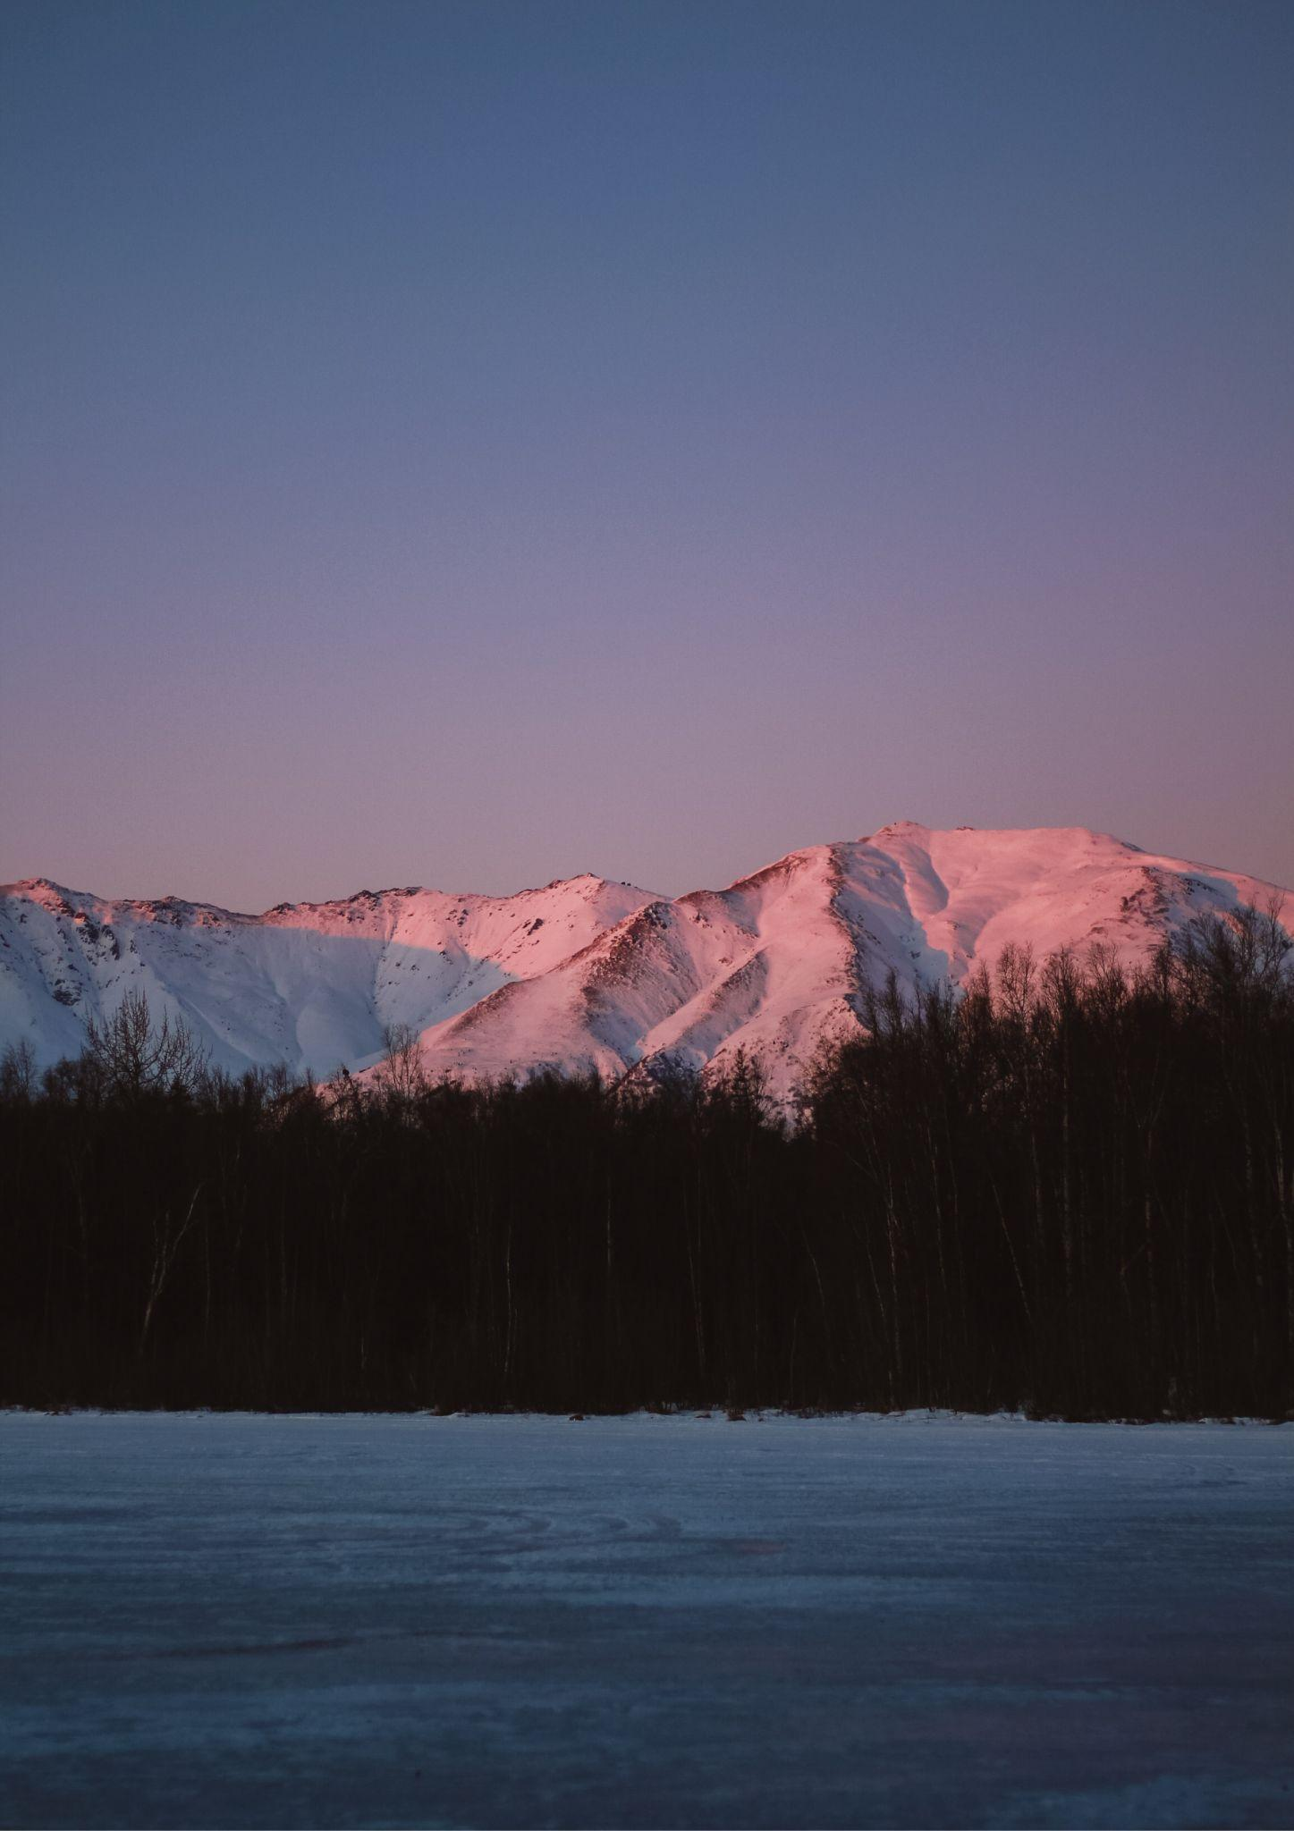
ALASKA
TRAVEL BUCKET LIST
Denali National Park
Anchorage
Tracy Arm Fjord
Alaska Highway
Kenai Fjords National Park
Alaska Highway
Alaska Railroad
Inside Passage
Dalton Highway
Gold Rush Park
Alaska Native Heritage
Alaska Rainforest
Mendenhall Glacier
Ketchikan
Elias National Park
Mendenhall Glacier
Iditarod Historic Trail
Glacier Bay National Park
Katmai National Park
Hubbard Glacier
Seward, Alaska
Alaska Talkeetna
State Historic Park
Skagway

